Slide 1
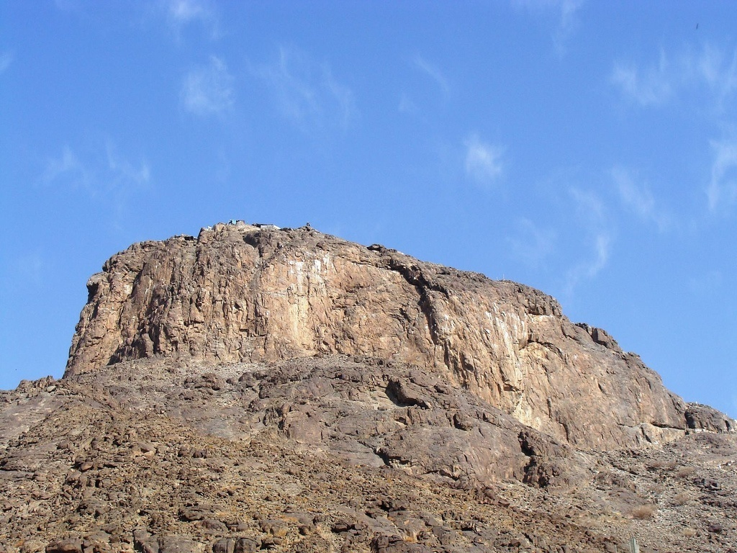
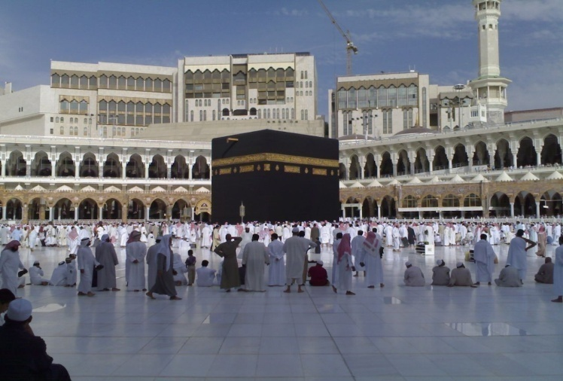
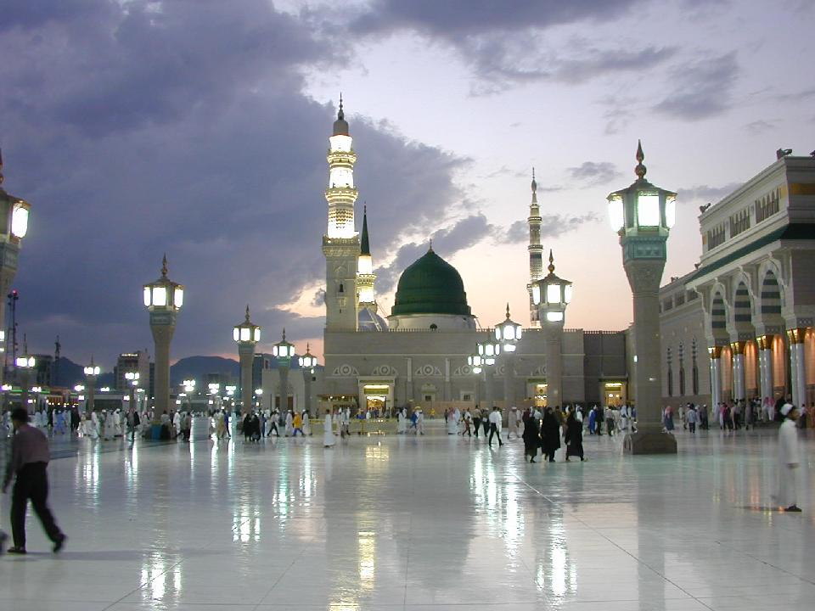
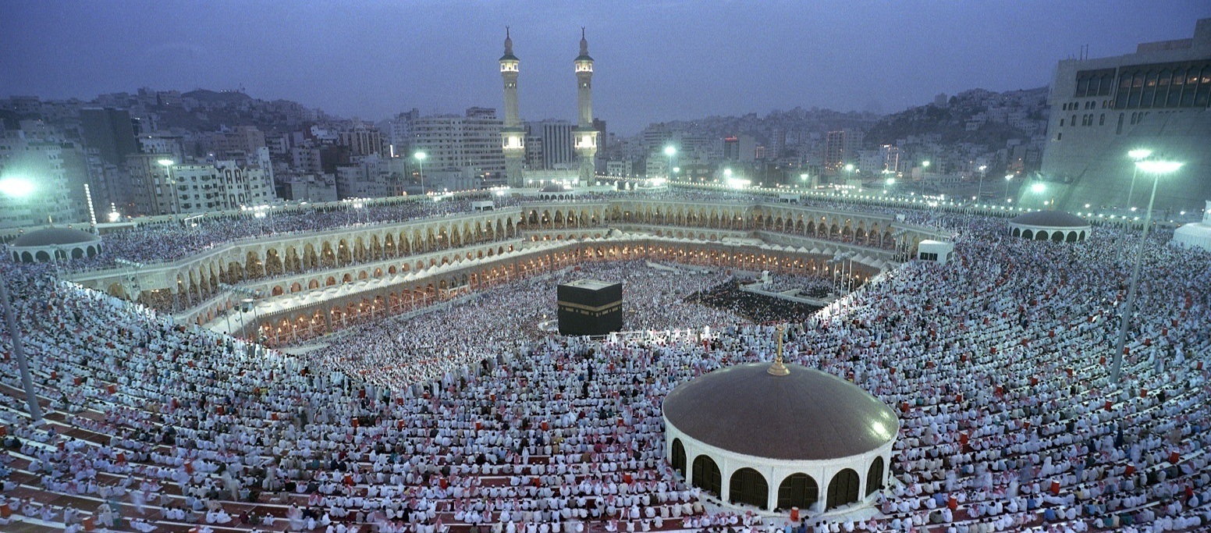
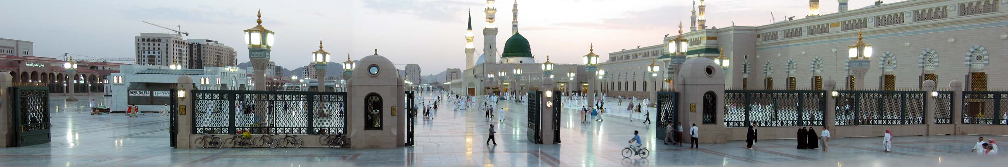
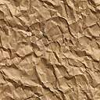
H A J J

Slide 2
Excellence of Hajj…

Slide 3
Excellence of Hajj (1)
The Prophet (صلى الله عليه وسلم) said: Umra is an expiation for the sins committed between it and the previous Umra; and the reward of Hajj Mabrur (i.e., one accepted) is nothing but Jannah. [Bukhari and Muslim] | عن ‏ ‏أبي هريرة رضي الله عنه ‏أن رسول الله ‏صلى الله عليه وسلم قال: ‏‏ العمرة إلى العمرة كفارة لما بينهما والحج المبرور ليس له جزاء إلا الجنة. ( البخاري ومسلم )
Narrated Abu Huraira: The Prophet (صلى الله عليه وسلم) said: Whoever performs hajj and does not commit any obscenity nor commit any evil, will return as sinless as a new-born child. [Bukhari and Muslim] | ‏عن أبي هريرة رضي الله عنه قال: سمعت النبي صلى الله عليه وسلم يقول: من حجّ فلم يرفث ولم يفسق رجع كيوم ولدته أمه. ( لفظ البخاري ) ولفظ مسلم: من أتى هذا البيت فلم يرفث ولم يفسق رجع كيوم ولدته أمه.

Slide 4
Excellence of Hajj (2)
The Prophet (صلى الله عليه وسلم) was asked: Which deed is the best? He (صلى الله عليه وسلم) replied: Faith in Allah and His Messenger. Then he was asked: What is next? He replied: Jihad (fighting) in the Cause of Allah. Then he was asked: What is after that? He replied: Hajj Mabrur. [Bukhari and Muslim] | عن ‏ ‏أبي هريرة ‏رضي الله عنه ‏ ‏قال:‏ ‏سئل النبي ‏ ‏صلى الله عليه وسلم: ‏أي الأعمال أفضل؟ قال: ‏ ‏إيمان بالله ورسوله، قيل: ثم ماذا؟ قال: جهاد في سبيل الله، قيل: ثم ماذا؟ قال: حج ‏‏ مبرور. ( البخاري ومسلم )
Aisha (رضي الله عنها) reported that she said: O Messenger of Allah! We consider jihad as the best deed. Should we not fight in Allah's Cause? He (صلى الله عليه وسلم) replied: For you (women) the best jihad: Hajj Mabrur. [Bukhari] | عن عائشة رضي الله عنها قالت: قلت يا رسول الله نرى الجهاد أفضل الأعمال، أفلا نجاهد؟ فقال: لَكُنَّ أفضل الجهاد، حج مبرور. ( البخاري )

Slide 5
Excellence of Hajj (3)
Aisha (رضي الله عنها) reported, Allah's Messenger (صلى الله عليه وسلم) said: There is no day when Allah sets free more servants from Hell Fire than the Day of Arafah. He draws near, then praises them to the angels, saying: What do these seek? [Muslim] | عن ‏عائشة رضي الله عنها‏ ‏أن رسول الله ‏ ‏صلى الله عليه وسلم ‏ ‏قال: ‏ ‏ما من يوم أكثر من أن يعتق الله فيه عبدا من النار من يوم ‏‏ عرفة ‏ ‏وإنه ‏ ‏ليدنو ثم ‏ ‏يباهي بهم الملائكة فيقول: ما أراد هؤلاء. ( مسلم )
Abdullah (رضي الله عنه) reported that the Prophet (صلى الله عليه وسلم) said: Alternate between Hajj and Umrah, for these two remove poverty and obliterate sins just as the blacksmith's bellows removes all impurities from metals like iron, gold and silver. The reward for Hajj Mabrur is nothing short of Paradise. [Nasaee and Tirmidhee] | ‏عَنْ ‏ ‏عَبْدِ اللهِ رضي الله عنه ‏قَالَ:‏ ‏قَالَ رَسُولُ اللهِ ‏ ‏صَلى اللهُ عَليْهِ وَسَلمَ: ‏ ‏تَابِعُوا بَيْنَ الْحَجِّ وَالْعُمْرَةِ فَإِنهُمَا يَنفِيَان الفقرَ وَالذنوبَ كمَا يَنفِي ‏ ‏الْكِيرُ ‏ ‏خَبَثَ ‏ ‏الحَدِيدِ وَالذهَبِ وَالفِضَّةِ وَليْسَ لِلْحَجِّ المَبْرُور ثَوَابٌ دُونَ الْجَنةِ. ( النسائي والترمذي )

Slide 6
Preparation for Hajj…
Aspects of Preparation
Debts
What to Take
Notes:
- Hadith “Verily, Allah is Good and only accepts the good.”
- Abu Hurayrah reported that the Prophet (صلى الله عليه وسلم) said: “If a man sets out with filthy earnings, places his foot in the stirrup (of his riding animal) and calls out: Labbayk Allahumma Labbayk (I hear your call and am coming. Oh Allah, I hear your call) - a caller will call from the heavens, You do not hear the call and you will not be pleased. Your provisions are Haram and your earnings are Haram and your Hajj is not blessed nor accepted.”

Slide 7
Preparation for Hajj (1)
Sincerity
Repentance from all past sins
Resolve outstanding differences and seek forgiveness from others
Pay/record all debts
Write/update your will
Make sure the wealth to be used for Hajj is from Halal sources
Choose the company of the righteous
Learn as much as possible about Hajj and Umra
Fiqh and “how to”
Meanings, spiritual and historical aspects
Notes:
- Hadith “Verily, Allah is Good and only accepts the good.”
- Abu Hurayrah reported that the Prophet (صلى الله عليه وسلم) said: “If a man sets out with filthy earnings, places his foot in the stirrup (of his riding animal) and calls out: Labbayk Allahumma Labbayk (I hear your call and am coming. Oh Allah, I hear your call) - a caller will call from the heavens, You do not hear the call and you will not be pleased. Your provisions are Haram and your earnings are Haram and your Hajj is not blessed nor accepted.”

Slide 8
Months & Days of Hajj
Months of Hajj
Hijri Calendar:
1. Muharram
2. Safar
3. Rabi’ al-Awwal
4. Rabi’ al-Thani
5. Jumada al-Ula
6. Jumada al-Thaniya
7. Rajab
8. Shaban
9. Ramadan
10. Shawwal (شوال)
11. Dhul-Qedah (ذو القعدة)
12. Dhul-Hijjah (ذو الحجة)
Days of Hajj
All in the 12th month, Dhul-Hijjah:
8th Dhul-Hijjah: day of Tarwiyah (يوم التروية)
9th Dhul-Hijjah: day of Arafah (يوم عرفة)
10th Dhul-Hijjah: day of NaHr (يوم النحر) (Eid)
11th Dhul-Hijjah: 1st day of tashreeq
12th Dhul-Hijjah: 2nd day of tashreeq
13th Dhul-Hijjah: 3rd day of tashreeq
Days of Tashreeq (أيام التشريق)
Months of Hajj
Go to http://www.islamicfinder.org and determine the
corresponding Gregorian dates.

Slide 9
Where is it located? - Geography of Hajj -
Mawaqeet
Haram of Makkah

Slide 10
Mawaqeet (1)
Mawaqeet (مواقيت) is the plural of Meeqat (ميقات): the geographical boundary that a person intending Hajj or Umra may not cross without assuming Ihram for Hajj or Umra, or both.
A Muslim intending Hajj or Umra who crosses the Meeqat without Ihram must return to the Meeqat and make Ihram from there. If he/she does not return and make Ihram from the Meeqat, then he/she must offer an animal sacrifice (Fidya).

Slide 11
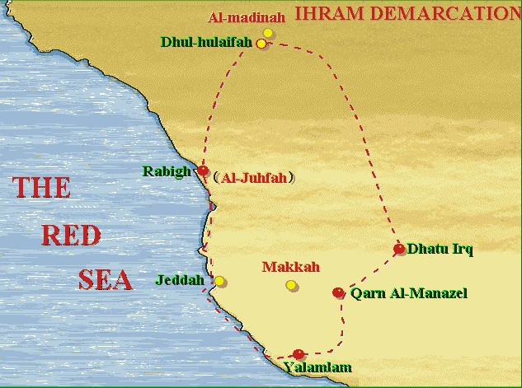
Dhu-l Hulayfah (ذو الحُليفة)
Coming from Madinah
Other names: Abyar Ali
~255 miles North of Makkah
Al Juhfah (الجُحفة)
Coming from North Africa, Syria, …
116 miles North West of Makkah
Rabigh: 127 miles North West of Makkah
Dhatu ‘Irq (ذات عرق)
Coming from ‘Iraq
Other names: Al Dhareeba
55 miles North East of Makkah
Qarn Al Manazil (قرن المنازل)
Coming from Najd (Ryadh, …), UAE, …
Other names: Qarn al-Manazil is a valley, the northern part is called As-Sayl al-Kabeer, and the southern part is called Wadi Mahram. The distance between the two is about 20 miles.
50 miles East of Makkah
Yalamlam (يلملم)
Coming from Yemen
Other names: As-Sa’diya
80 miles South of Makkah
Notes:
Jeddah is inside the limits of the Meeqats…

Slide 12
Haram of Makkah حَرَمُ مكة
The Haram of Makkah is the sanctified area surrounding Makkah. It was delimited by Ibraheem (عليه الصلاة والسلام) under the guidance of Jibreel (عليه السلام).
After FatH Makkah (the opening of Makkah), Prophet Muhammad (صلى الله عليه وسلم) sent Tameem Ibn Asd al-Khuza'ee to renew the boundaries of the Haram.
Flags have been put on the mountains and hills to indicate the limits of the Haram. The number of flags reached 943 at some point, but most of them are ruined.
Area of the Haram = 212 mi² (550 Km²)
Perimeter of the Haram = 79 mi (127 Km)

Slide 13
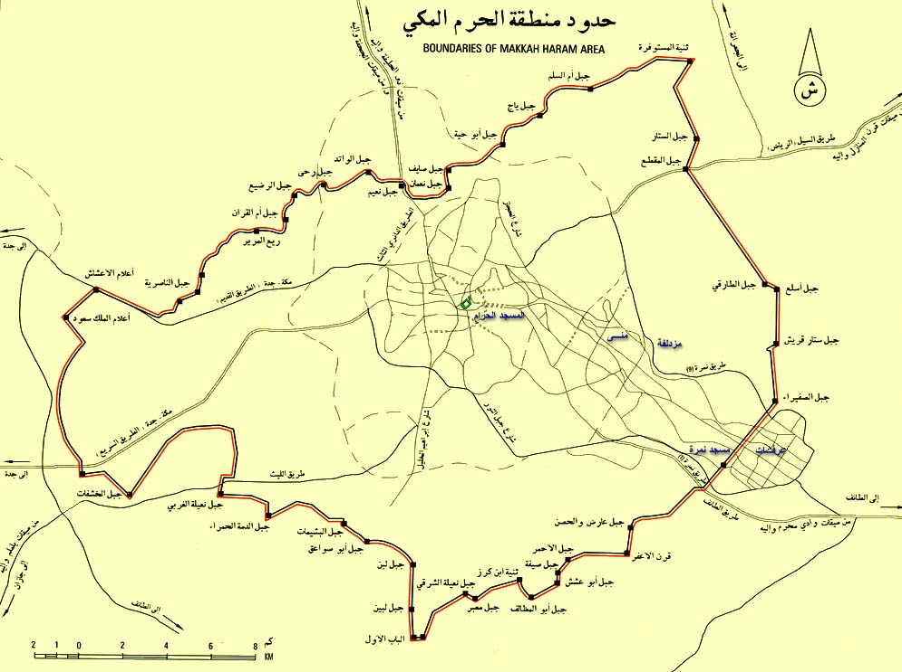
Haram of Makkah - map
N
Al-Masjid al-Haram
To Madinah
Muzdalifah
To Jeddah
Mina
City of Makkah
Arafah

Slide 14
Limits of the Haram of Makkah
N
Ji'ranah
Tan’eem (التنعيم): 4.6 miles North
Nakhlah (نخلة) : 8 miles N.E.
Hudaybiyah (الحديبية) : 13.5 miles W.
Adhah Libn (أضاه لبن) : 10 miles S.
Arafah (عرفة) : 13.5 miles E.
Ji’ranah (الجِعْرانة) : 13.5 miles N.E.
Tan'eem
Nakhlah
Hudaybiyah
Makkah
Arafah
Adhah Libn

Slide 15
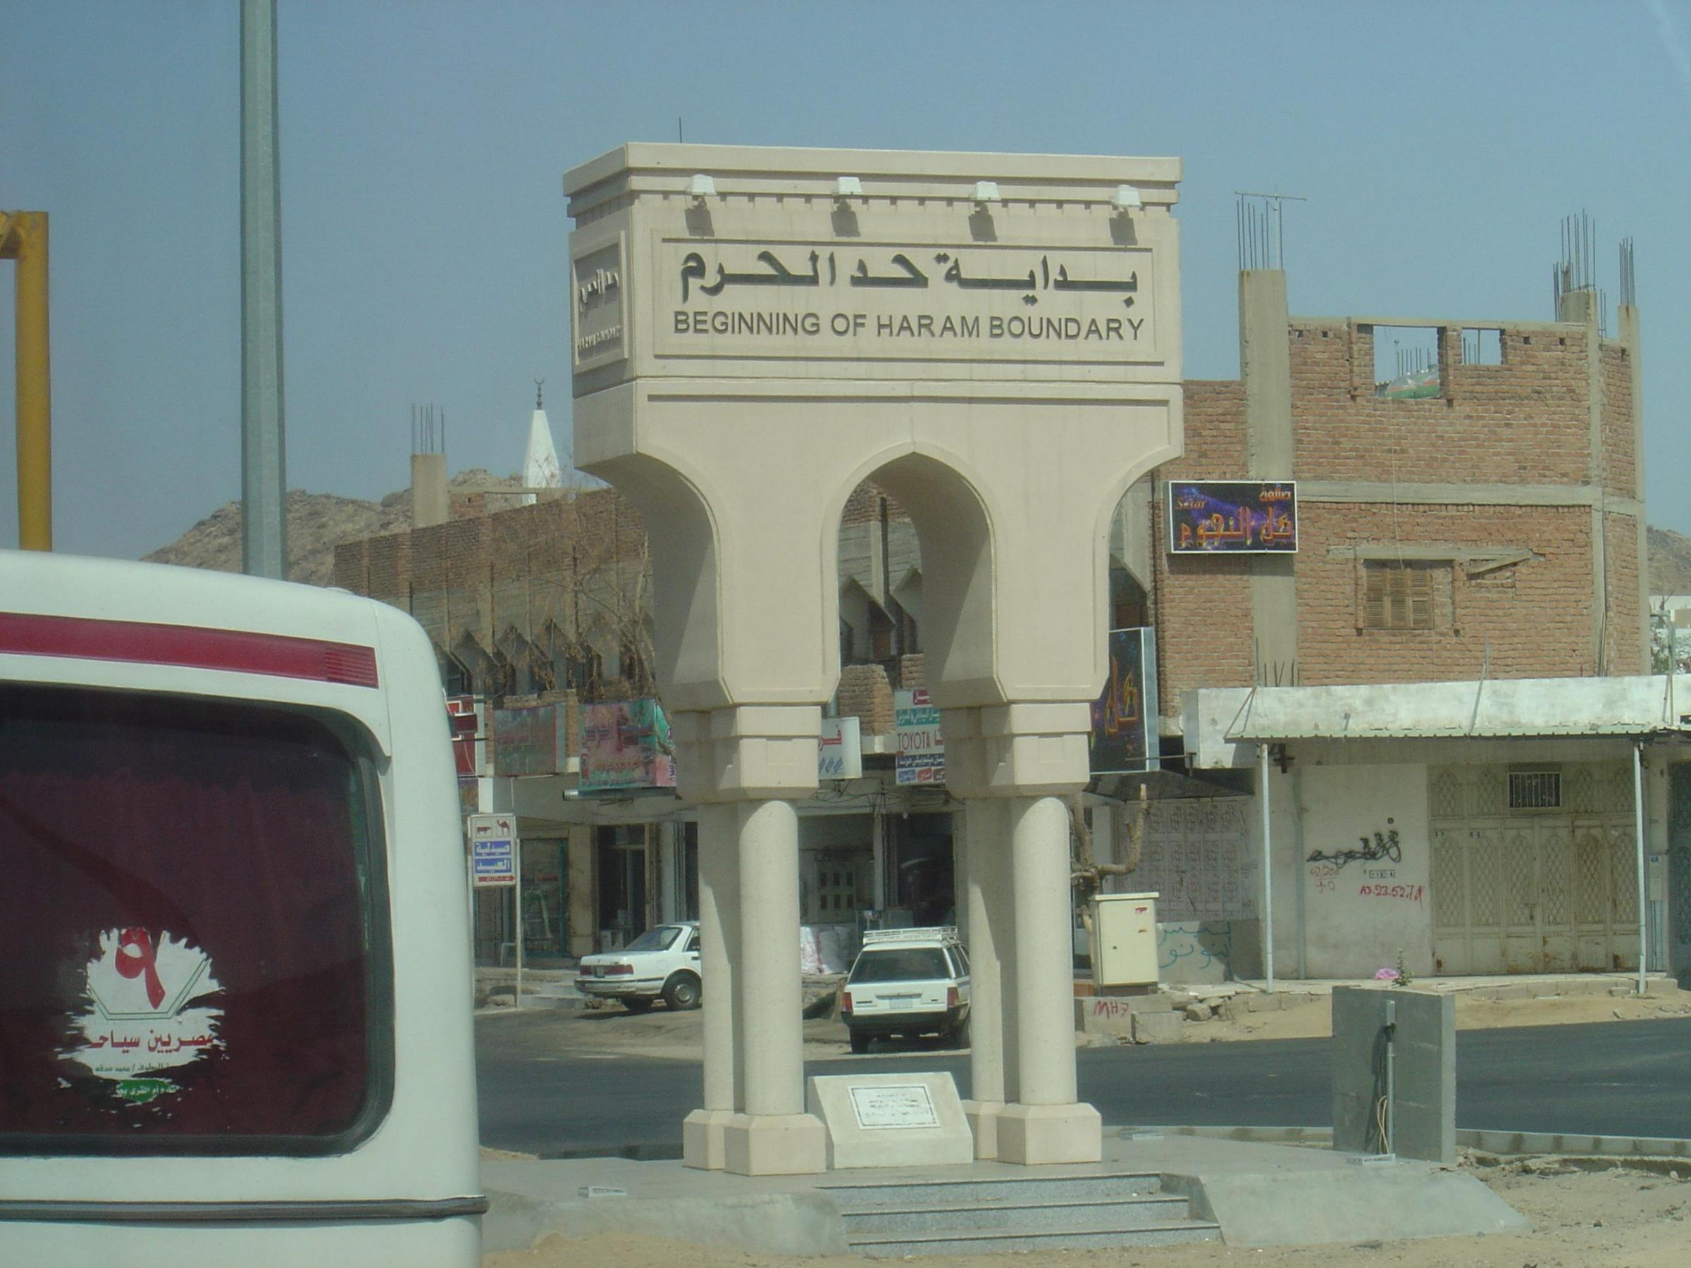
Haram Boundary
Haram Boundary

Slide 16
The Haram is sanctified
"Surely (as for) those who disbelieve, and hinder (men) from Allah's way and from the Sacred Mosque which We have made equally for all men, (for) the dweller therein and (for) the visitor, and whoever shall incline therein to wrong unjustly, We will make him taste of a painful chastisement." [Surat al-Hajj, 25] | إِنَّ الَّذِينَ كَفَرُوا وَيَصُدُّونَ عَنْ سَبِيلِ اللَّهِ وَالْمَسْجِدِ الْحَرَامِ الَّذِي جَعَلْنَاهُ لِلنَّاسِ سَوَاءً الْعَاكِفُ فِيهِ وَالْبَادِي وَمَنْ يُرِدْ فِيهِ بِإِلْحَادٍ بِظُلْمٍ نُذِقْهُ مِنْ عَذَابٍ أَلِيمٍ ( الحج، 25 )

Slide 17
Restrictions while in the Haram of Makkah
Its plants must not be cut,
Its game must not be frightened,
Articles lost in it must not be picked up except by someone making announcement to find the owner,
Nor is any man to bear arms for fighting in it.
Note: the above is part of a Hadith of the Prophet (صلى الله عليه وسلم)
These restrictions apply to the haram of Madinah as well.
They apply to everyone whether in a state of Ihram or not, during any time of the year.

Slide 18
Mawaqeet & Haram of Makkah
Dhu-l Hulayfah
N
Al JuHfah
Dhatu ‘Irq
Tan'eem
Ji'ranah
Jeddah
Nakhla
Qarnu-l Manazil
Hudaybiyah
Makkah
Arafah
Adhah Libn
Haram
of Makkah
Yalamlam
Note: for illustration purposes only, does not scale.

Slide 19
Definitions Kinds of Hajj Hajj & Umra for Women

Slide 20
Kinds of Hajj
Tamattu’ ( التمتع )
Umra then Hajj during the months of Hajj
Pilgrim called Mutamatti’ (متمتع)
Requires Hady (animal sacrifice)
Umra
Hajj
Qiran ( القِران )
Combined Umra and Hajj during the months of Hajj
Pilgrim called Qaarin (قارن)
Requires Hady (animal sacrifice)
Umra
Hajj
Ifrad ( الإفراد )
Hajj only during the months of Hajj
Pilgrim called Mufrid (مفرد)
Does not require Hady
Hajj
The Prophet (صلى الله عليه وسلم) asked his companions to do Tamattu’, even though he did Qiran because he brought the Hady (animal for sacrifice) with him.

Slide 21
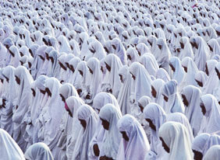
Hajj & Umra Rituals for Women
General Rule
Narrated Jabir: … 'Aisha accompanied him (i.e. the Prophet صلى الله عليه وسلم) to Makkah while she got her menses. The Prophet (صلى الله عليه وسلم) commanded her to perform all the Manasik except Tawaf and Salat until she gets clean… [Bukhari] | عن جابر بن عبد الله قال: ... وكانت عائشة ‏قدمت معه ‏مكة وهي حائض فأمرها النبي ‏صلى الله عليه وسلم أن تنسك المناسك كلها غير أنها لا تطوف ولا تصلي حتى تطهر... ( البخاري )

Slide 22
Umra (العمرة) Summary
Ihram (الإحرام)
Tawaf (الطواف)
Sa’y between as-Safa and al-Marwa (السعي بين الصفا و المروة)
Halq (الحلق) (shaving the head)
or Taqseer (التقصير) (trimming the hair)

Slide 23
Ihram for Umra (1)
If you are coming from outside (Africa, Europe, Madinah, etc.), assume Ihram at or before the Meeqat.
If you are within the Mawaqeet limits but outside the Haram of Makkah (like Jeddah), assume Ihram from your place.
If you are inside the Haram of Makkah (in your residence in Makkah for example) then you have to go outside the Haram of Makkah to make Ihram (this is a requirement for Umra).
Tan'eem (or Masjid 'Aisha) is the closest point outside the Haram of Makkah. You have SAPTCO buses from the Saptco Bus Stop in front of King Fahd Gate, running 24hrs between Haram and Tan’eem. Or take a taxi.
Dhul-Hulayfah
A
B
Tan'eem
Ji'ranah
C
Nakhla
Hudaybiyah
Makkah
Arafah
Adhah Libn
Notes:
- 'a'eshah, wife of the Prophet (صلى الله عليه وسلم), said: “I used to put scented oils on the Messenger of Allah when making Ihram, before he completed Ihram and for his Hall (coming out of Ihram) before he made Tawaf of the House.”

Slide 24
Contents of Part 2 Umra Step by Step
Umra Step by Step
Ihram & Talbiyah الإحرام والتلبية -
Tawafالطواف -
Sa’y between Safa and Marwa - السعي بين الصفا والمروة
Halq or Taqseer (Shaving or Hair Cutting) - الحلق أو التقصير
Stay in Makkah

Slide 25
Ihram for Umra (2)
Preparation for Ihram
Clip moustache.
Clip nails; remove pubic and armpit hair.
Take a shower (Ghusl) for Ihram. This is a Sunnah.
Put perfume on your body (head, beard, …).
Put Ihram garments (Rida’ & Ezar) (رداء و إزار) – (Men only).
Pray two Rak’at, or a prescribed Salat, if it’s time for it.
Notes:
- 'a'eshah, wife of the Prophet (صلى الله عليه وسلم), said: “I used to put scented oils on the Messenger of Allah when making Ihram, before he completed Ihram and for his Hall (coming out of Ihram) before he made Tawaf of the House.”

Slide 26

Ihram for Umra (3)
Note: Up to this point, all what you did is preparation for Ihram.
Make the intention and say:
Labbayka Allahumma Umra Here I am O Allah, (intending) Umra | لبيك اللهم عمرة
!

Slide 27
Talbiyah (1)
After intention is made, recite Talbiyah aloud:
Labbaika-llaahumma labbaik labbaika laa shareeka laka labbaik inna-l hamda wa-n ni'mata laka wa-l mulk, laa shareeka lak Here I am O Allah, here I am. Here I am, there is no partner with You, here I am. Verily all praise is for You, and every bounty is from You, and all dominion is Yours - You have no partner. | لبيك اللهم لبيك، لبيك لا شريك لك لبيك، إن الحمد والنعمة لك والملك، لا شريك لك
From this point you are in a state of Ihram
Notes:
- The Prophet (صلى الله عليه وسلم) was reported to have said, Jibreel came to me to convey Allah's message that I should command my followers to say Talbeeyah in a loud voice.

Slide 28
Talbiyah (2)
Talbiyah should be continued until you see the Ka’bah (or until the Ramy of the largest Jamrah in the case of Hajj).
Make Talbiyah especially:
while descending or ascending during travel,
joining a party of people,
after every Salat,
and in the morning and evening
Notes:
- The Prophet (صلى الله عليه وسلم) was reported to have said, Jibreel came to me to convey Allah's message that I should command my followers to say Talbeeyah in a loud voice.

Slide 29
Talbiyah (3)
Talbiyah should be recited aloud. Making Talbiyah in a low voice is against the Sunnah of the Prophet (صلى الله عليه وسلم).
The Prophet (صلى الله عليه وسلم) said: Jibreel came to me and asked me to tell my companions to raise their voices with Ihlal (i.e. Talbiyah). [Ahmed and Tirmidhi] | في الحديث عن الرسول صلى الله عليه وسلم قال: إن جبرائيل أتاني فأمرني أن آمر أصحابي أن يرفعوا أصواتهم بالإهلال. ( أحمد والترمذي )
Narrated Abu-Bakr As-Siddeeq (رضي الله عنه): the Prophet (صلى الله عليه وسلم) was asked: what is the best of Hajj? He said: al-'ajj (i.e. raising the voice with Talbiyah) and ath-Thajj (i.e. shedding blood for the sake of Allah: animal sacrifice). [Tirmidhi, Ibn Majah, Daarimi] | عن ‏ ‏أبي بكر الصديق رضي الله عنه أن النبي ‏صلى الله عليه وسلم سُئل: أي الحج أفضل؟ قال: العج والثج. ( الترمذي و ابن ماجه و الدارمي )
Notes:
- The Prophet (صلى الله عليه وسلم) was reported to have said, Jibreel came to me to convey Allah's message that I should command my followers to say Talbeeyah in a loud voice.

Slide 30
Ihram & Talbiyah for Women
It is equally a Sunnah for a woman to shower before Ihram.
A woman in her Hayd (menstruation) or Nifaas (post-natal bleeding) takes a shower and assumes Ihram, but does not pray the 2 Rak’at of Ihram.
The majority of scholars say that a woman should make Talbiyah in a low voice.

Slide 31
Prohibitions of Ihram (1) محظورات الإحرام
Clothing:
Men cannot wear any sewn clothes such as a shirt, turban, hooded cloak, trousers, underwear, etc., socks or shoes. Women can wear their normal clothes, but without covering their faces or hands.
What is forbidden to wear during the state of Ihram is not stitched materials in themselves but those garments that are made to fit the limbs and are usually worn by people in normal state, such as shirts, pants and T-shirts.
You should not wear gloves, although there is no harm in wrapping the hands in cloth.
Men cannot cover their head with something that touches it.

Slide 32
Prohibitions of Ihram (2) محظورات الإحرام
Fragrance:
You should not perfume yourself, your clothing, your food or drink after entering Ihram. You should also abstain from cleansing yourself with scented soap.
There is no harm in what remains of the effect of perfume used prior to Ihram.

Slide 33
Prohibitions of Ihram (3) محظورات الإحرام
Sexual intercourse:
… and all matters leading to it such as kissing, touching, or talking with one's wife/husband about intercourse or related matters.
Cleansing:
You should not remove any hair from any part of the body.
You should not clip your nails.
You should not kill lice.
Scholars differed about taking a bath, unless it is for Janabah (wet dream). But it is reported that the Prophet (صلى الله عليه وسلم) took a bath while in a state of Ihram.

Slide 34
Prohibitions of Ihram (4) محظورات الإحرام
Hunting:
You should not hunt or assist someone in hunting.
You should not kill animals except those that are harmful or that would attack people, such as mice, snakes and scorpions.

Slide 35
Permissible of Ihram
There is no harm in using an umbrella, the roof of a car or tent for shade.
There is also no harm in carrying your baggage atop your head, or carrying a backpack.
Wearing sandals that do not cover the ankles.
Wearing a ring or a watch (on your wrist or hung from your neck).
Wearing a hearing aid, a speech aid.
Wearing eye glasses or contact lenses.
According to most scholars, it is permissible for you to cleanse yourself with unscented cleansers and to wash and scratch your head and body, even if some of your hair falls unintentionally.
Washing your Ihram garments or put on new ones.
Wearing a belt to keep your money and documents, and to tie your Ezar (the lower part of the Ihram). Stitched belts are permissible.

Slide 36

Pitfalls of Ihram (1)
Crossing the Meeqat without Ihram. This violates a Wajib and requires an animal sacrifice.
Thinking that Ihram is putting the 2 towels. Making the intention of Hajj or Umra or both is the essence of Ihram.
Thinking that the 2 Rak’at before Ihram are a condition to Ihram or a Wajib. Ihram is valid even without any Salat.
Thinking that Ghusl (shower) or Wudu is a condition of Ihram. It is only a Sunnah, and the Ihram is valid without it.
Uncovering the right shoulder (Idtiba’) at the Ihram and during all the Hajj and Umra. Idtiba’ is a Sunnah during the Tawaf of arrival ONLY.

Slide 37
Pitfalls of Ihram (2)
Thinking that anything that has stitches is forbidden to wear during Ihram. Only sewn clothes made to fit the limbs are forbidden.
Women in their menses thinking that they cannot assume Ihram and pass the Meeqat without Ihram. The only ritual a woman in her menses cannot perform is Tawaf.
Women thinking that Ihram requires particular clothes or white clothes. The only Ihram requirement for women is to uncover their face and hands.
Starting a Hajj or Umra and quitting before completing it. After Ihram is made the Hajj or Umra must be completed, regardless of whether it’s the Fardh Hajj or Nafl (optional).

Slide 38
Going to al-Masjid al-Haram…

Slide 39
Makkah…

Slide 40
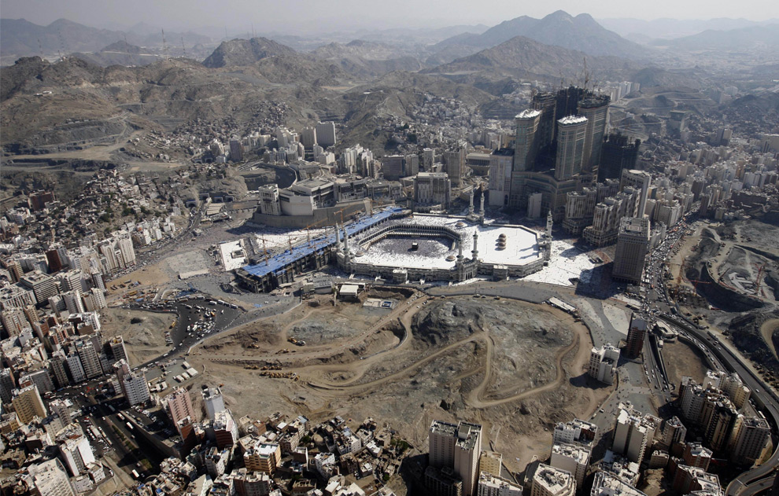
Haram Expansion (1430H/2009)

Slide 41
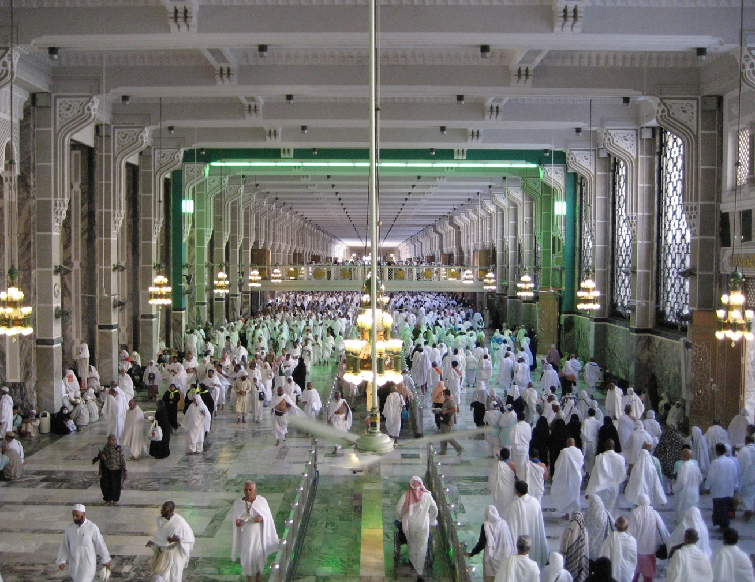
Mas'aa Before the Expansion

Slide 42
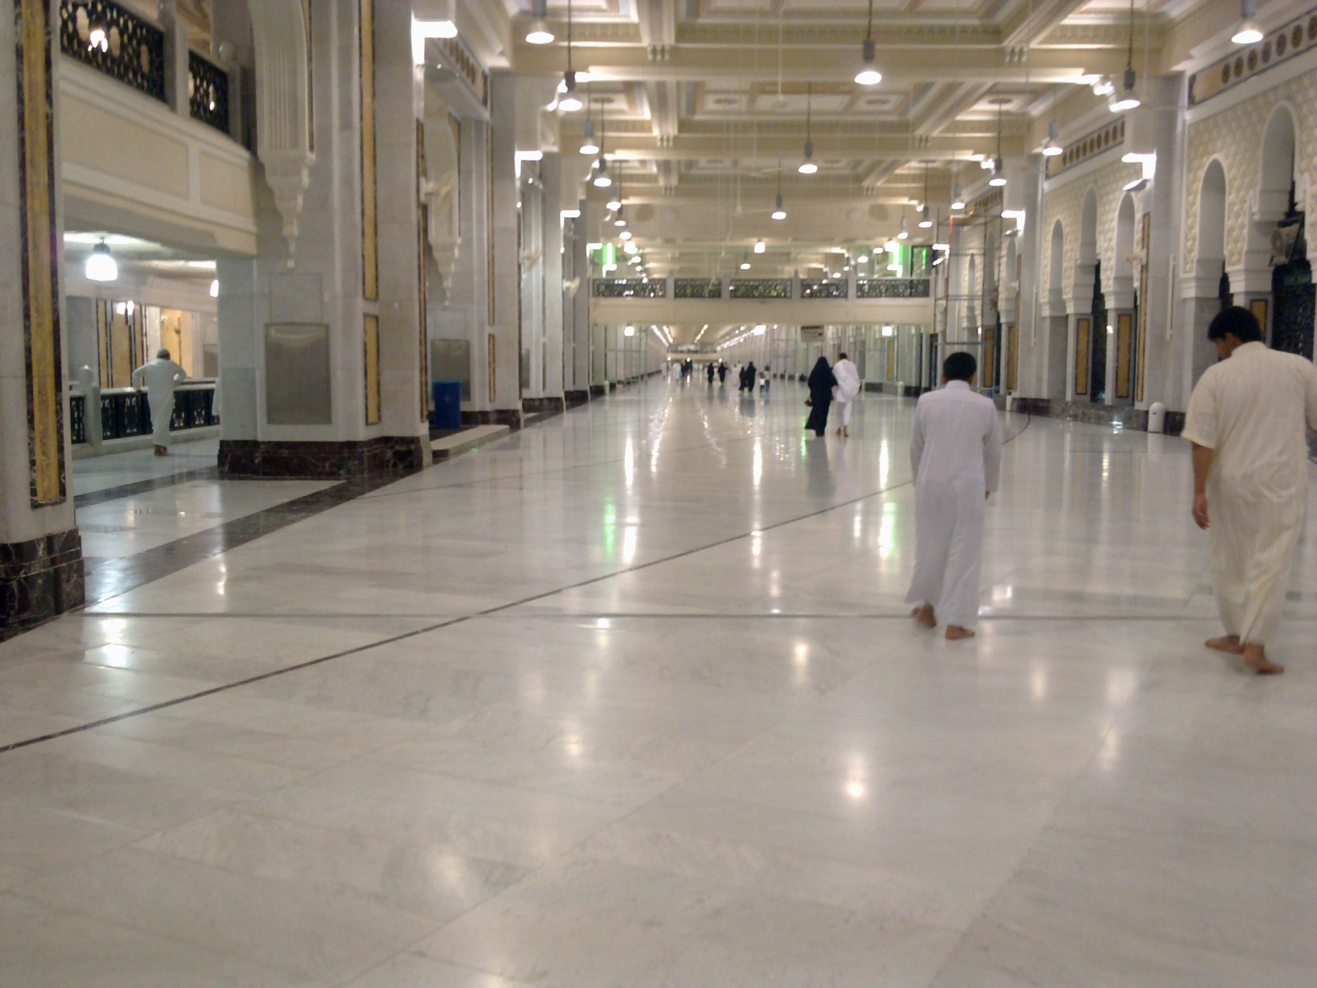
New Expanded Mas'aa (1431H/2010)

Slide 43
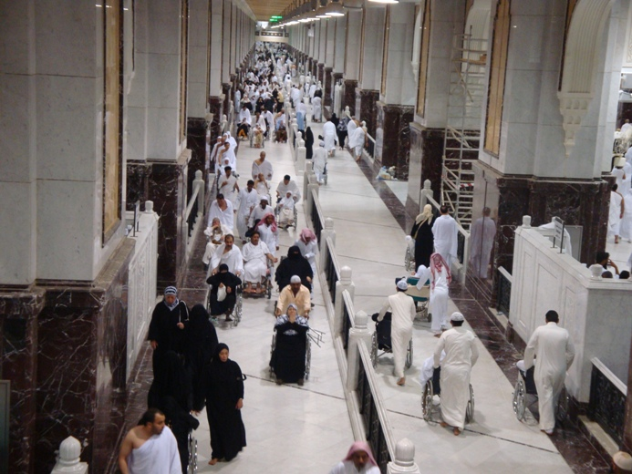
New Wheelchair mas'aa
New Expanded Wheelchair Mas'aa

Slide 44
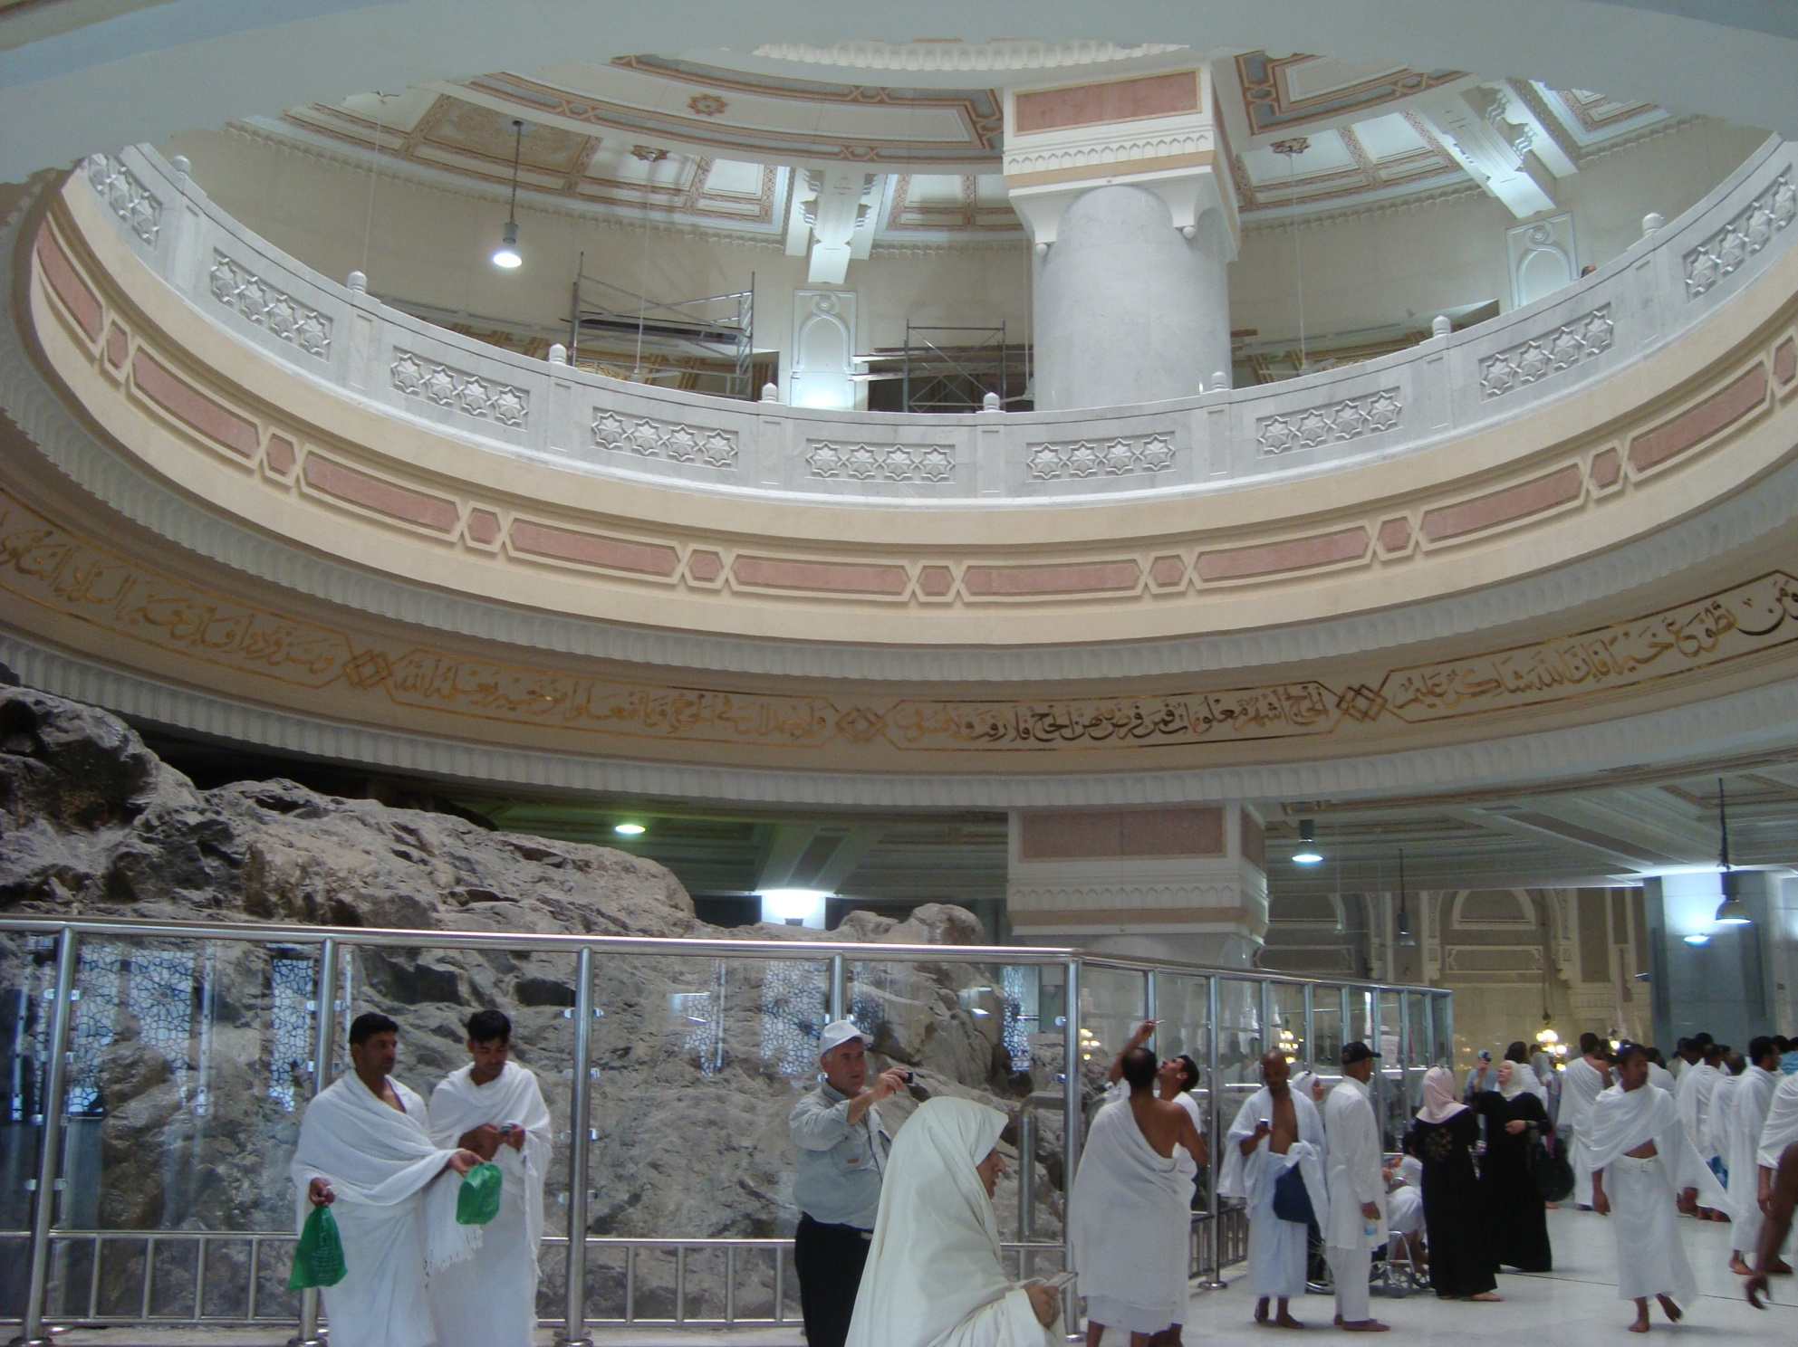
New Wheelchair mas'aa
New Safa Area (1431H/2010)

Slide 45
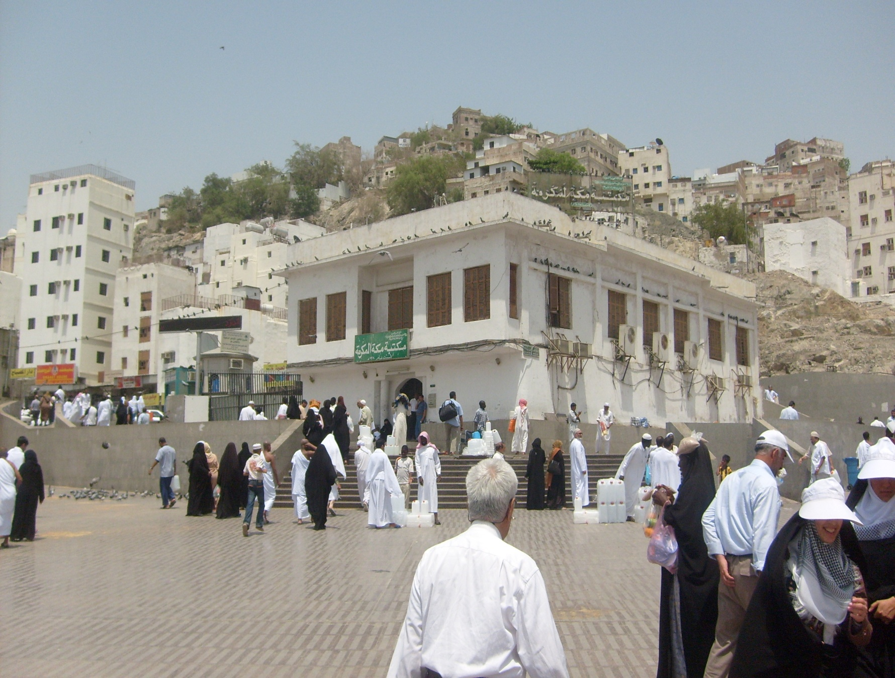
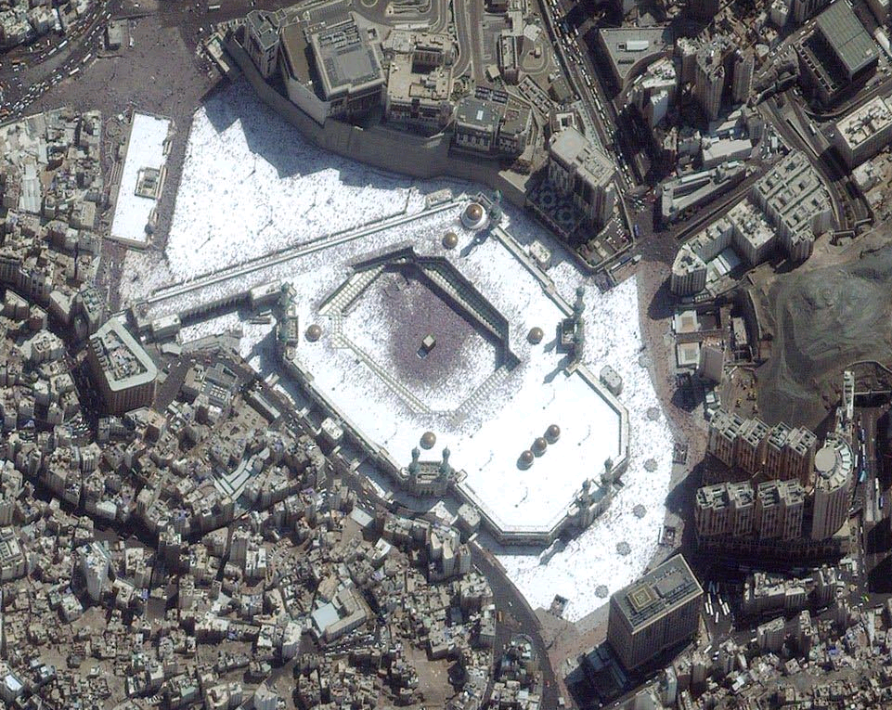
Al-Masjid Al-haram (1)
Lost & Found (#13)
Black Stone Corner
Assalam Gate (#24)
Safa
Birthplace of
the Prophet
(صلى الله عليه وسلم)
Yamani Corner
0.23mi / 0.38km
AbdulAziz Gate (#1)
0.4mi/0.65km
Tawaf on the
3rd floor
Marwa
0.5mi/0.8km
Fath Gate (#45)
Fahd Gate (#79)
Umra Gate (#62)

Slide 46
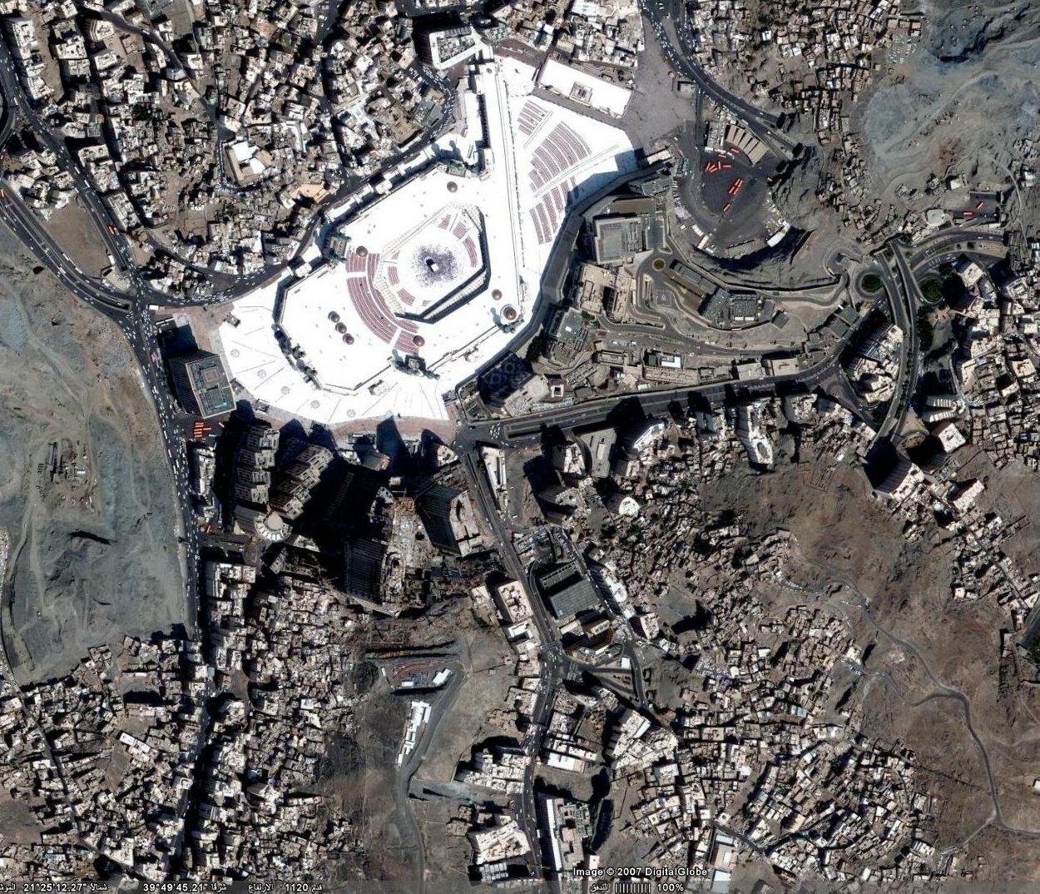
Makkah Hotels - Satellite
Sofitel
Le meridien
H
O
T
E
L
S
Ajyad As-Sud St.
Tawheed
Ajyad St.
Elaf Ajyad
Hilton
Ajyad
Abraj Al-Bait
Elaf Kenda
Shohadaa

Slide 47
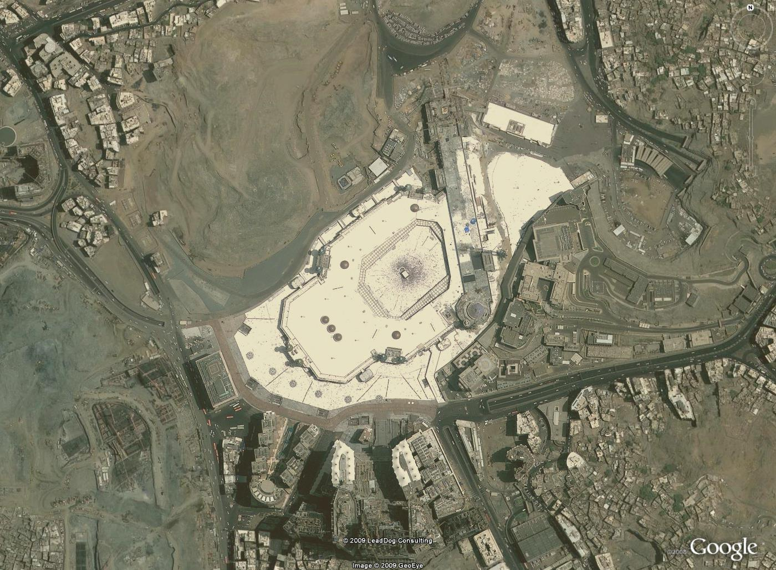
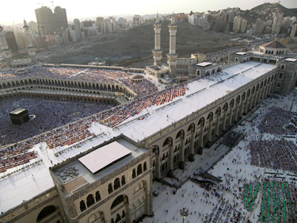
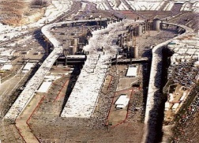
Al-Shamiyya
expansion project
Mas’aa being expanded
Jabal Omar
expansion project
Abraj al-Bait

Slide 48
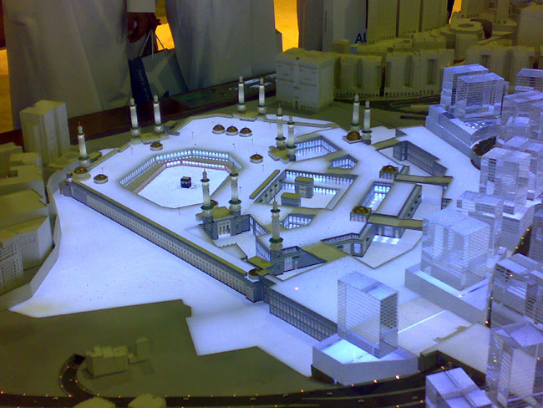

Slide 49
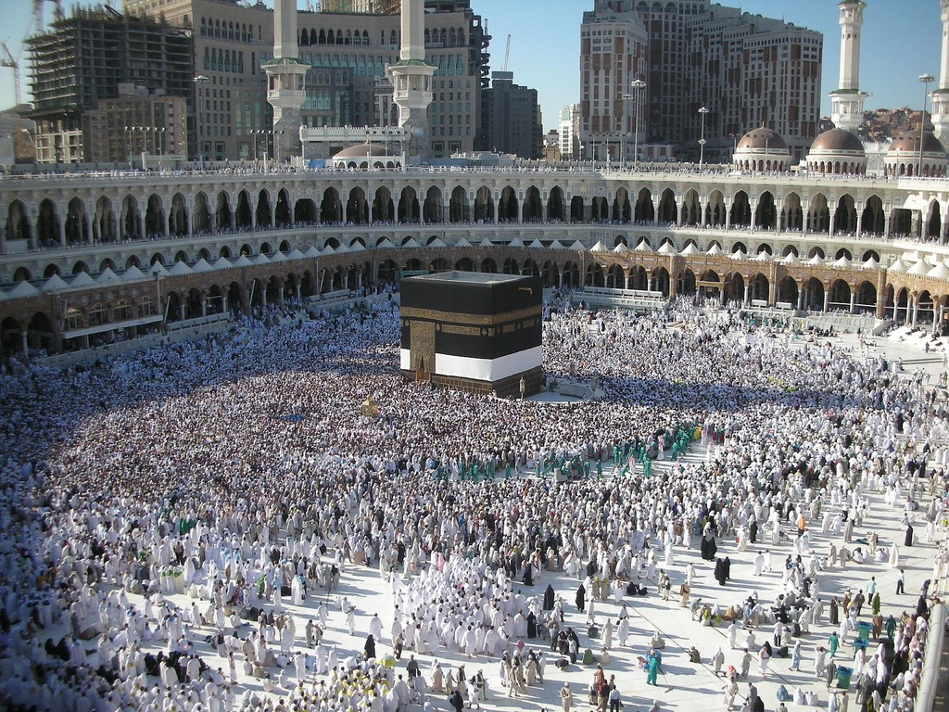
Al-Masjid Al-haram (2)
Abraj Al-Bait
Abraj Makkah
(Hilton)
Yamani Corner
Door of the Ka’bah
Shami Corner
Black Stone Corner
King Fahd Gate
To the Safa
Iraqi Corner
Hijr al-Ka'bah
(Hateem)
Zamzam tap water
Maqam Ibraheem

Slide 50
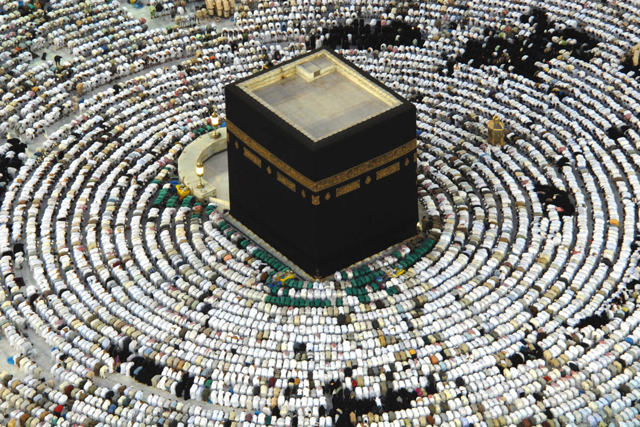
Can you name it?
?
Iraqi Corner
?
Maqam Ibraheem
?
Hijr al-Ka'bah
Direction to ?
To Zamzam
?
Shami Corner
Direction to ?
To the Safa
?
Black Stone Corner
?
Yamani Corner

Slide 51
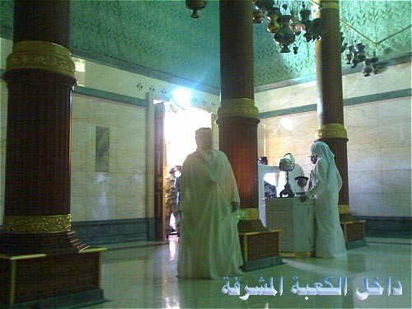
Ka’bah from inside

Slide 52
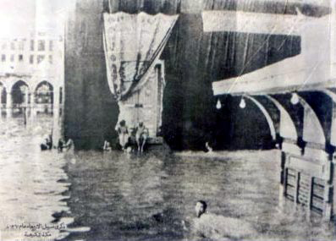
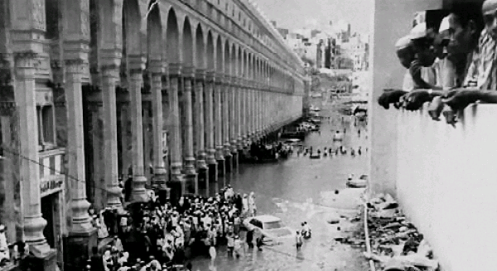
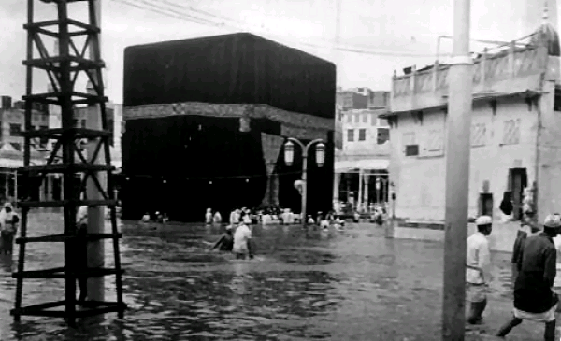
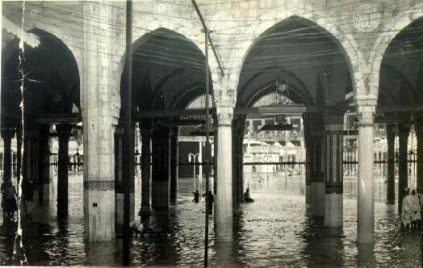
From the Past (floods)

Slide 53
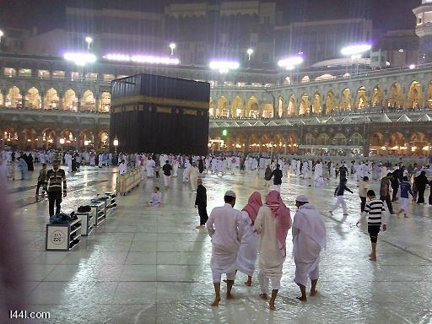
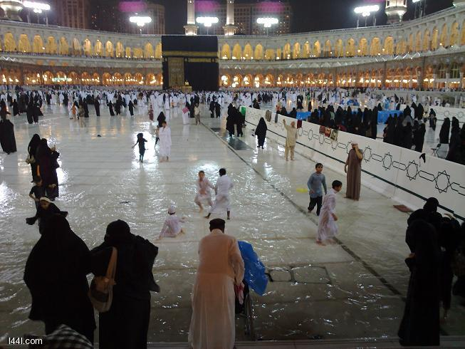
Rainy Days
Nowadays, rain does not prevent people from performing Tawaf.

Slide 54
Tawaf طواف
SUMMARY
Arrive at Al-Masjid Al-Haram (المسجد الحرام)
The Black Stone (الحجر الأسود)
Tawaf
Al-IdTiba’ ( الإضطِبَاع )
Ar-Ramal ( الرَّمَل )
Pray two Rak’at of Tawaf

Slide 55
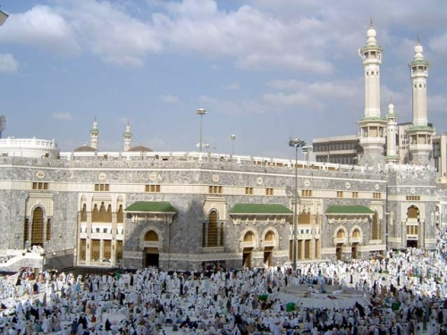
Arrive at Al-Masjid Al-Haram (1)
Take a bath (Ghusl) before entering Makkah, if possible (Sunnah).
When you enter the Masjid do not forget to enter by the right foot, and say:
Allaahumma salli `alaa muhammadin wa sallim, allaahumma aftah lee abwaaba rahmatika. O Allah, send prayers and peace upon Muhammad (pbuh), O Allah open the doors of Your mercy for me. | اللهم صل على محمد وسلم، اللهم افتح لي أبواب رحمتك
A'oodhu billaahi-l `adheem wa bi wajhihi-l kareem wa sultaanihi-l qadeem Mina-sh shaitaani-r rajeem. I take refuge with Allah, the Supreme, and with His Noble Face, and His eternal authority from the accursed devil. | أعوذ بالله العظيم وبوجهه الكريم وسلطانه القديم من الشيطان الرجيم

Slide 56
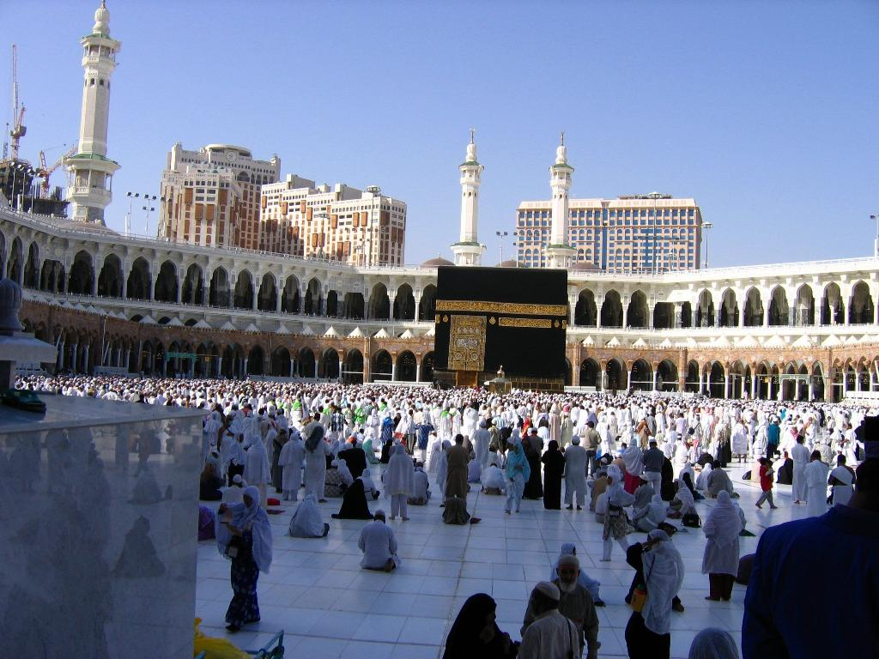
Arrive at Al-Masjid Al-Haram (2)
When you see the Ka'bah raise your hands if you want to - as it is established from Ibn `Abbas.
And there is no Du'a established from the Prophet at this point. So you may make Du'a with whatever you wish.
You should not believe that you have to enter the Masjid from a particular gate. It is permissible to enter from any gate.

Slide 57
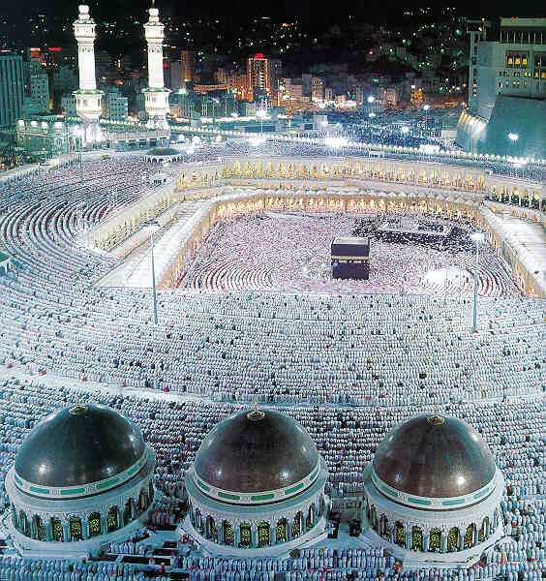
Arrive at Al-Masjid Al-Haram (3)
Du’a established from `Umar (رضي الله عنه):
Allaahumma anta-s salaam wa minka-s salaam fa Hayyinaa rabbanaa bi-s salaam. O Allah! You are the Peace, from You is the Peace. O Allah! Greet us with the Peace. | اللهم أنت السلام ومنك السلام فحيِّنا ربنا بالسلام

Slide 58
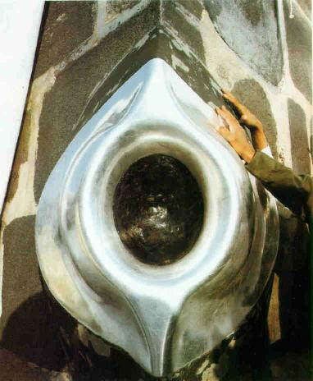
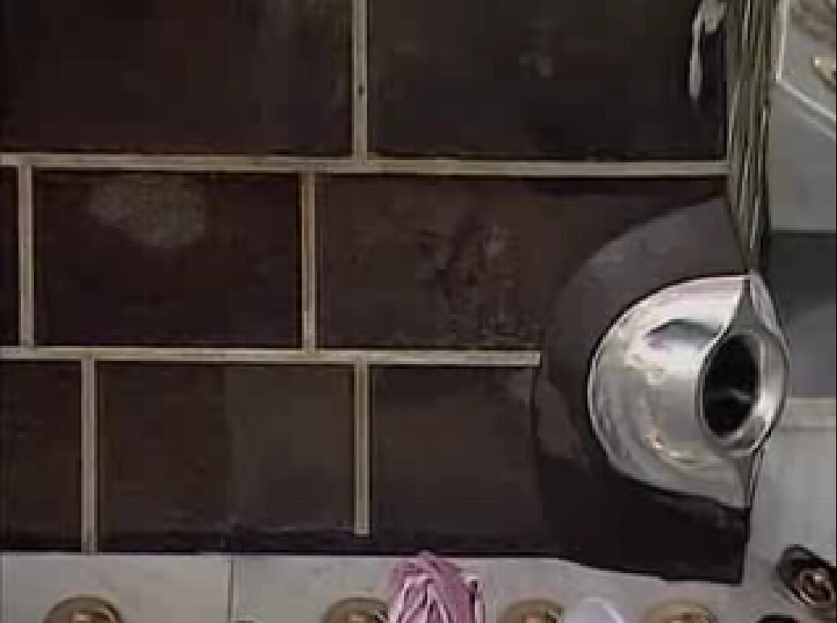
The Black Stone (1)
Go straight to the Black Stone and facing it make Takbeer.
Then touch it with your right hand and kiss it, and make Sajda upon it also, as the Prophet (pbuh) did that.
If your are not able to kiss it then touch it with your right hand then kiss your hand.
If you cannot touch it you should make a sign towards it with your right hand and say Takbeer, but do not kiss your hand.
And you do that in every circuit.

Slide 59
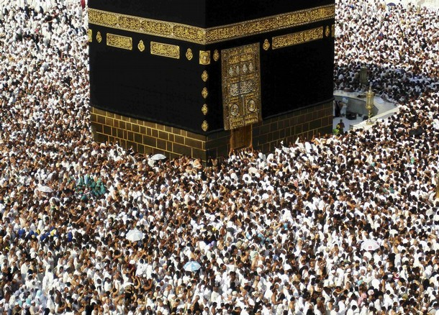
The Black Stone (2)
You do not have to touch the Black Stone for your Tawaf to be accepted. If it is crowded you may face your hand toward the Stone and say Allahu Akbar.
Do not push and crowd to get to the Black Stone, according to the Prophet's saying to ‘Umar.
Hurting a Muslim is a great sin, while kissing the Black Stone is a Sunnah, not a Wajib.
Do not stand at the Black Stone line for a long time. Make a sign towards it with your right hand, say Allahu Akbar and move on.

Slide 60
The Black Stone (3)
Excellence in touching the Black Stone
The Prophet (صلى الله عليه وسلم) said: "Allah will raise up the Stone on the Day of Resurrection, and it will have two eyes with which it will see, and a tongue which it talks with, and it will witness in favor of everyone who touched it in truth." [Ahmad and ad-Daarimee] | ‏عَنِ ‏ ‏ابْنِ عَبَّاسٍ رضي الله عنه ‏أَنَّ رَسُولَ اللَّهِ ‏ ‏صَلَّى اللَّهُ عَلَيْهِ وَسَلَّمَ ‏ ‏قَالَ: ‏‏ لَيَبْعَثَنَّ اللَّهُ الْحَجَرَ يَوْمَ الْقِيَامَةِ وَلَهُ عَيْنَانِ يُبْصِرُ بِهِمَا وَلِسَانٌ يَنْطِقُ بِهِ يَشْهَدُ بِهِ لِمَنْ اسْتَلَمَهُ بِحَقٍّ . ( أحمد والدارمي )
And said: "Touching the Black Stone and the Yamani corner removes sins." [Made Hasan by at-Tirmidhee. Made Saheeh by Ibn Hibbaan, al-Haakim and Adh-Dhahabee] | وقال: مسح الحجر الأسود والركن اليماني يحطان الخطايا حطا. ( حسنه الترمذي وصححه ابن حبان والحاكم والذهبي )
And said: "The Black Stone is from Paradise, and it used to be whiter than snow, but the sins of the idolaters turned it black." [Made Saheeh by at-Tirmidhee and Ibn Khuzaimah] | ‏عَنِ ‏ ‏ابْنِ عَبَّاسٍ رضي الله عنه ‏أَنَّ رَسُولَ اللَّهِ ‏ ‏صَلَّى اللَّهُ عَلَيْهِ وَسَلَّمَ ‏ ‏قَالَ: ‏‏ الْحَجَرُ الْأَسْوَدُ مِن الْجَنَّةِ وَكَانَ أَشَدَّ بَيَاضًا مِنْ الثَّلْجِ حَتَّى سَوَّدَتْهُ خَطَايَا أَهْلِ الشِّرْكِ . ( أحمد و الترمذي )

Slide 61
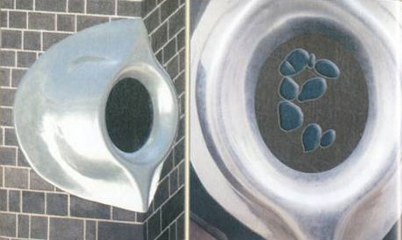
The Black Stone (4)
The Black Stone is broken into pieces as a result of damage inflicted through the ages (fire, flood, removal by the Qarmatians in 930 and returned back in 951).
The remaining pieces are cemented and held in a silver frame.

Slide 62
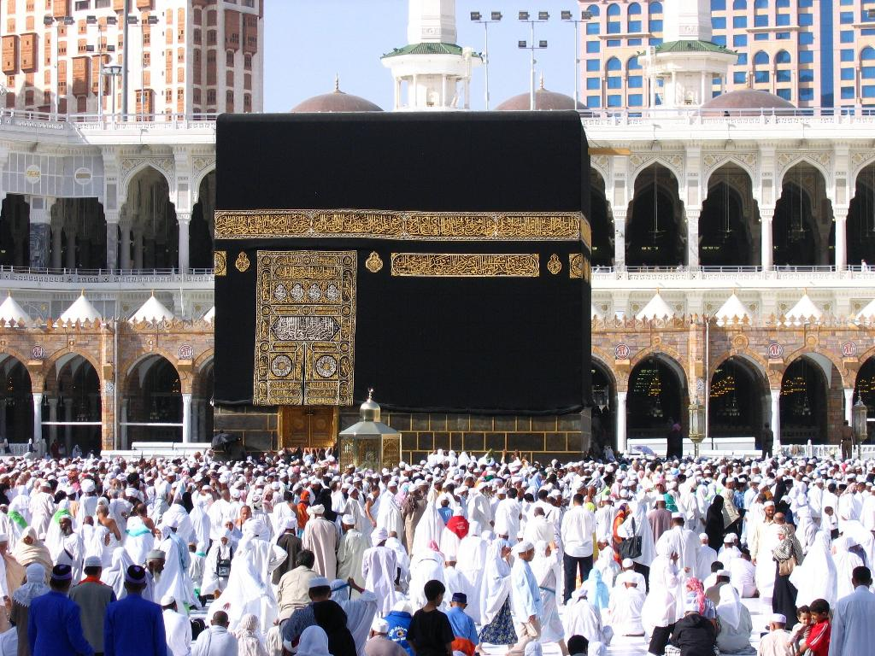
Tawaf طواف
Tawaf around the Ka'bah
Start from the Black Stone
Ka’bah being to your left
Go around the Ka’bah past the Black Stone seven times
Kiss the Black Stone or say Takbeer every time you pass by it (i.e. every circuit)

Slide 63
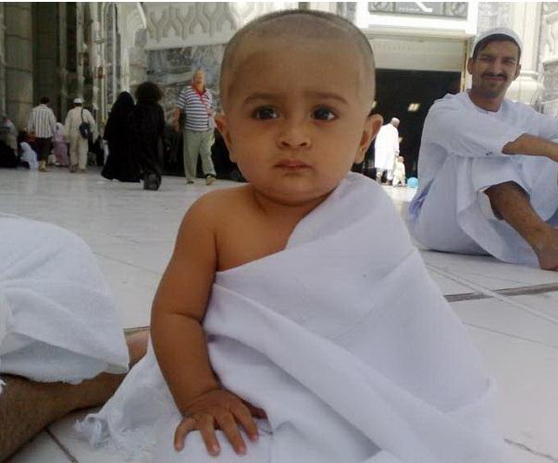
Tawaf (2) طواف
Two Sunnahs apply to this Tawaf:
Ar-Ramal (الرَّمَل)
(for men only)
a strong and quick walk with boldness, in which the shoulders are thrust forwards
in the first three rounds, then walk normally in the rest
Al-Idtiba‘ (الإضطِبَاع)
(for men only)
wearing the Ihram under your right armpit and over the left shoulder
throughout the seven rounds of Tawaf

Slide 64

Tawaf
N
Hijr al-Ka'bah
Shami Corner
Iraqi Corner
Ka'bah
Maqam
Ibraheem
Door
To Zamzam
Yamani Corner
Black Stone
To the Safa
Start Line

Slide 65
Tawaf (1)
All kinds of Tawaf, including optional Tawaf, consist of seven circuits around the Ka'bah.
The Ka’bah should be to your left. Do not do Tawaf with your back or right to the ka’bah. Do not walk backwards.
Tawaf shall be performed within the boundaries of Al-Masjid Al-Haram.
A state of Wudu is required for all kinds of Tawaf.
A menstruating woman does not make Tawaf until she becomes clean.
You do not have to say your intention out loud to begin Tawaf. Saying intentions out loud is something the Prophet (صلى الله عليه وسلم) never did except after Ihram when he said, “Labbayk Allahuma Umra wa Hajj.”
Notes:
The Prophet said : “Tawaf around the House is prayer, except that Allah has allowed speech in it, so he who speaks then let him not say except, good things and in a narration : so let him limit his talk in it.“
- The Prophet said to 'a'ishah when she came to make Umra in the final Hajj: “Do as anyone making Hajj does, except do not make tawaf of the House (and do not pray) until you become clean.”

Slide 66
Tawaf (2) - Interruption
Continue Tawaf without interruption, unless it is necessary, otherwise it will be void.
When it is time for the obligatory Salat you stop your Tawaf, join the Salat in your place and then resume your Tawaf from where you left.
If you need to go to the restroom you may interrupt your Tawaf and go. Make Wudu before coming back to resume your Tawaf. You resume your Tawaf from where you left. However, some scholars say that you need to start over from the beginning (this is a safer option).

Slide 67
Tawaf (3) - Doubt
In case of doubt about the number of circuits you performed you have to base your decision on the least number of circuits. For example if you have doubts whether you did 6 or 7 circuits, you base it on 6 and add one circuit.
If you get doubts after you finish your Tawaf then you just ignore it and do not act on it.

Slide 68
Tawaf (4) – The Other Corners
Touch the Yamani corner with your right hand each time you pass and do not kiss it. If you are not able to touch it then you should not make any sign towards it with your hand at all.
Do not face your hand to the Yamani corner and say Allahu Akbar. This is only for the Black Stone.
You do not touch the Shami or the 'Iraqi Corners at all.
Do not wipe the walls of the Ka’bah during Tawaf. The Messenger of Allah (صلى الله عليه وسلم) did not touch anything other than the Black Stone and the Yamani Corner.

Slide 69
Tawaf (5) – Du'a
There is no particular dhikr for Tawaf, so you may read Quran or say any dhikr you like.
Do not follow those Du’a books that make up a specific Du’a for each circuit around the Ka’bah. Read Quran and make Du’a from your heart and glorify Allah.
Make Du’a by yourself, do not do it in a shouting group.
You can say the Prophet’s Du’a between the Yamani and the Black Stone corners:
ربنا آتنا في الدنيا حسنة وفي الآخرة حسنة وقنا عذاب النار
Rabbanaa aatinaa fi-d dunyaa hasanatan wa fi-l aakhirati hasanatan wa qinaa 'adhaaba-n naar. | O Allah give us good in this life, and good in the Hereafter, and save us from the Punishment of the Fire.

Slide 70
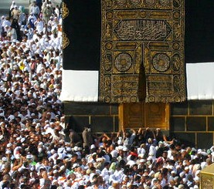
Al-Multazam الملتزم
Al-Multazam: you may cling to the place between the corner of the Black Stone and the Door of the Ka’bah (~6.5ft), placing your chest and face and forearms upon this place, and making Du’a.

Slide 71
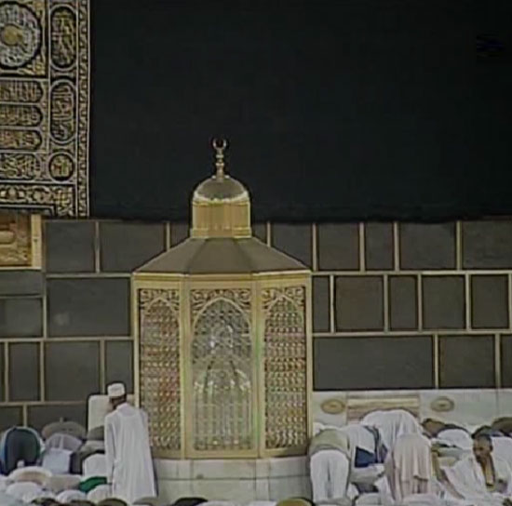
Maqam Ibraheem (1) مقام إبراهيم
When you finish the 7th round cover your right shoulder and move to the Place of Ibraheem and recite:
و اتخذوا من مقام إبراهيم مصلى
Wa-t takhidhoo min maqaami Ibraaheema musallaa. “And appoint for yourselves a place of prayer on the standing-place of Ibraheem.“ [2,125]
Place the Maqam Ibraheem between yourself and the Ka'bah and then pray two Rak'at. And recite therein Surat Al-Kafiroon and Surat Al-Ikhlas.

Slide 72
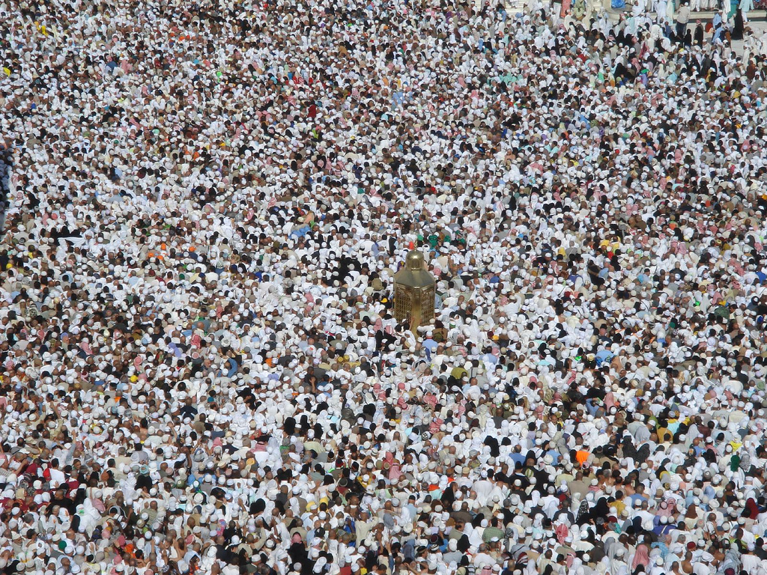
Maqam Ibraheem (2)
It is not always possible to pray behind the Maqam because of the people making Tawaf. Trying to pray right behind the Maqam in such conditions would be a sinful act.

Slide 73
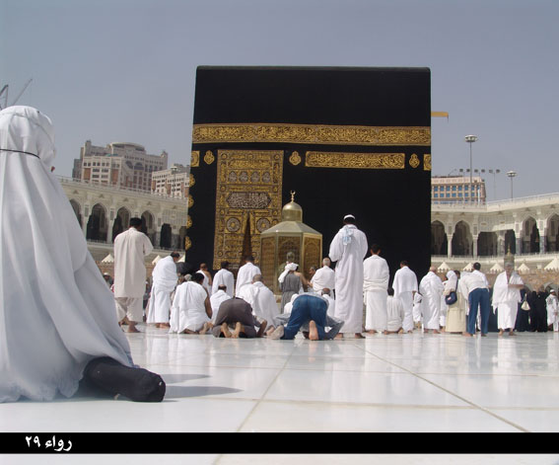
Maqam Ibraheem (3)
It is usually possible to have the Maqam in front of you while you pray the 2 Rak'as of Tawaf if you keep clear from the Tawaf area. If this is still not possible then you can pray anywhere in the Masjid.

Slide 74
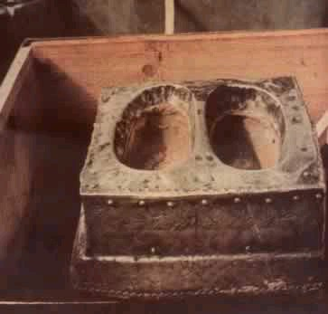
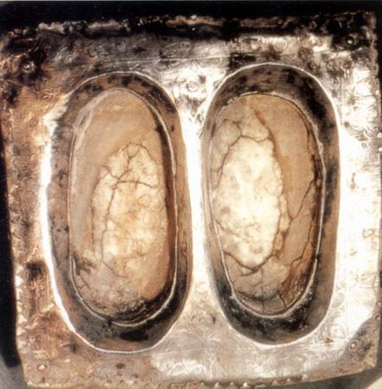
Maqam Ibraheem (4)
Traces of Prophet Ibraheem’s feet (عليه السلام) as seen inside the structure. This is Maqam Ibraheem (not the structure).

Slide 75
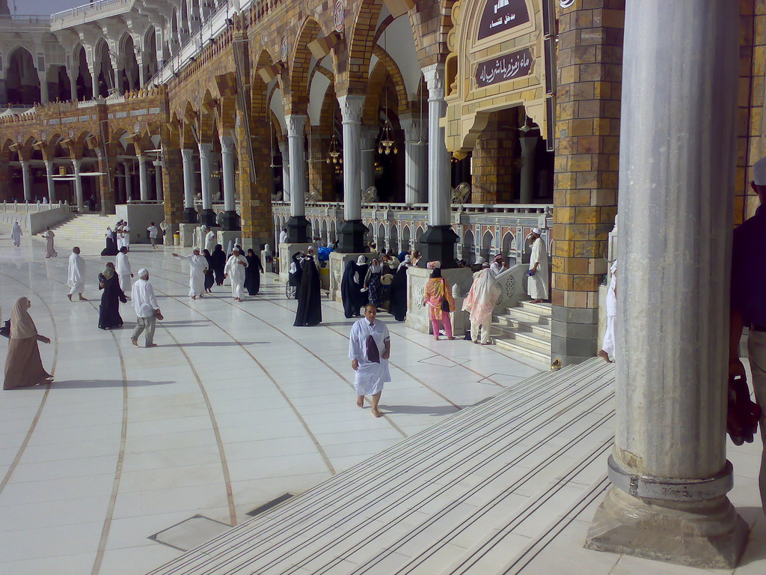
Zamzam (1) زمزم
After praying you go to Zamzam and drink from it, and pour some of the water on your head.
Then you return to the Black Stone, say Takbeer and touch it, as before, if possible.
Zamzam Tap Water
Notes:
- The prophet (صلى الله عليه وسلم) said : "Zamzam water is for what it drunk for" and he said "It is blessed and it is a food and a cure for illness" and he said : The best water upon the face of the earth is Zamzam water, in it is nourishment and a cure from illness.

Slide 76
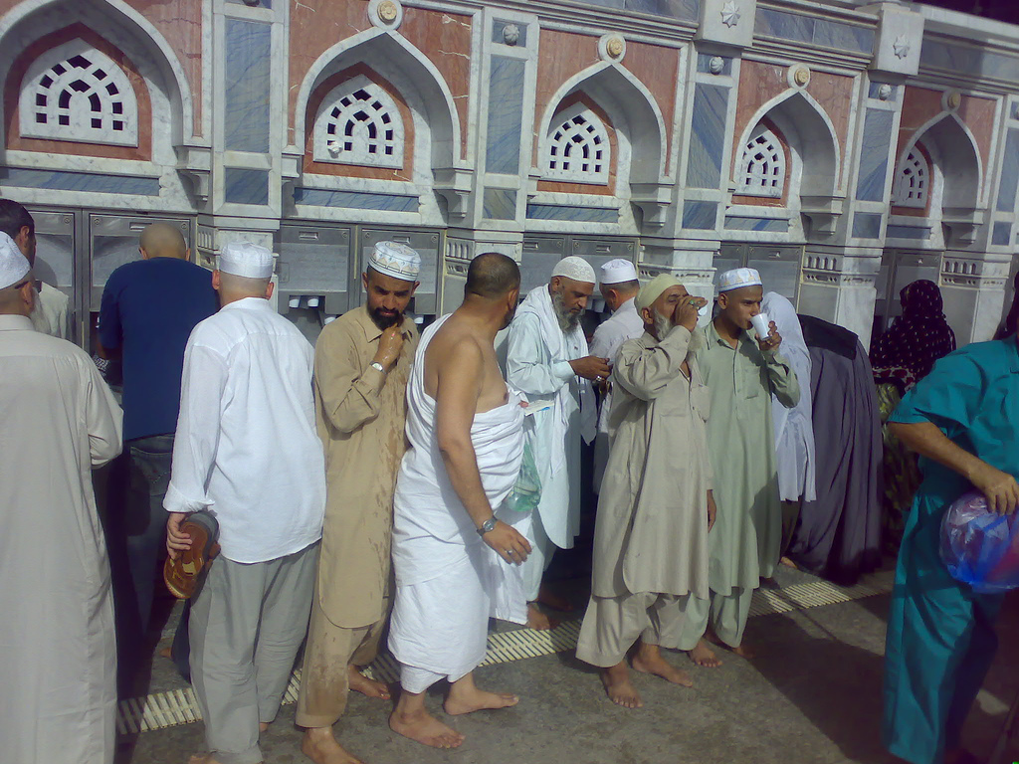
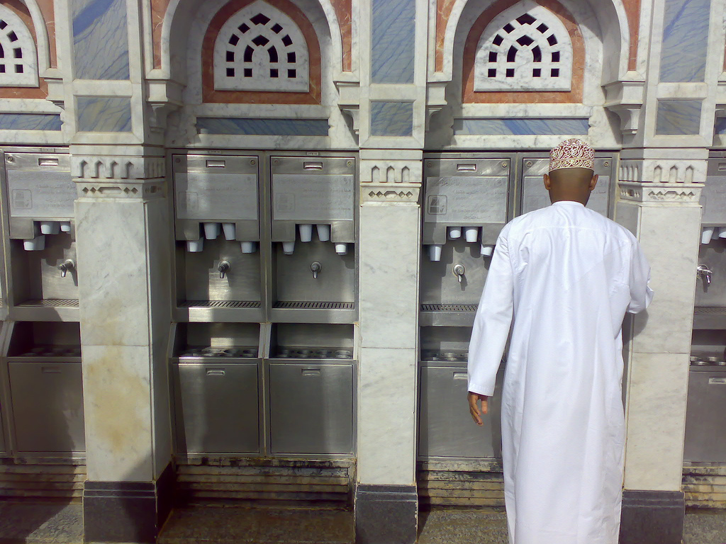
Zamzam (2)
Zamzam Tap Water

Slide 77
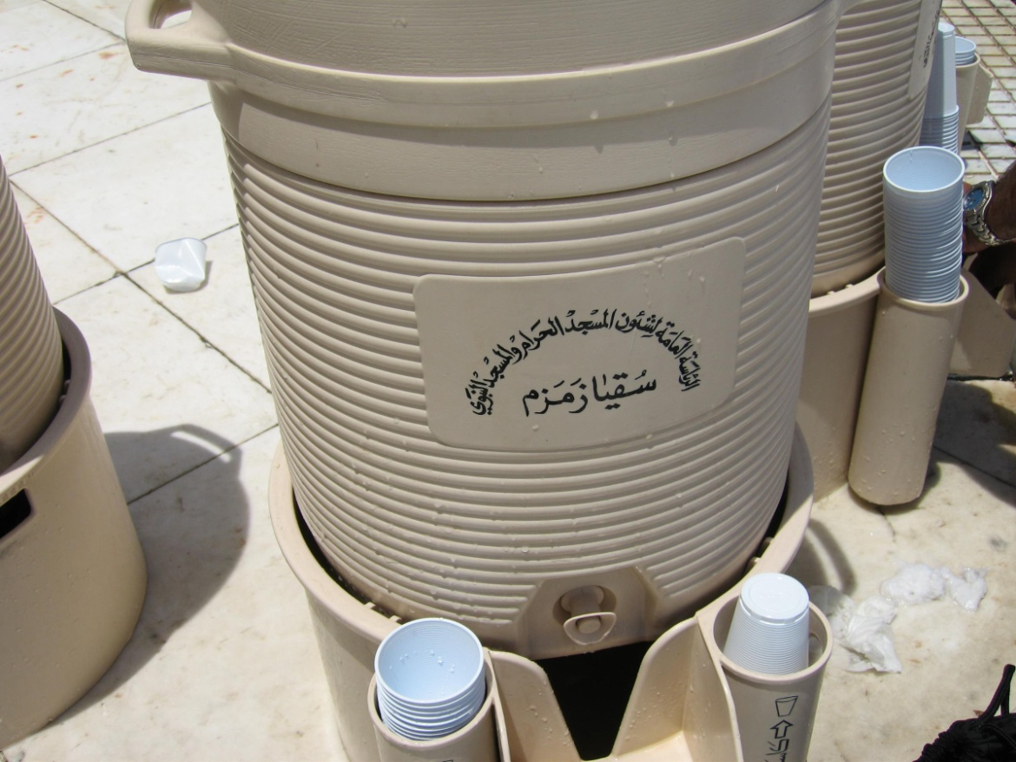
Zamzam (3) زمزم
Zamzam water is available in coolers (cold and not cold) everywhere in the Masjid.
During the Hajj season coolers are removed from the Tawaf area, but will be available in other areas of the Masjid.
Zamzam water in coolers

Slide 78
Zamzam (4)
The Prophet (صلى الله عليه وسلم) said: “Zamzam water is for whatever (purpose) it is drunk for.” [Ahmad and Ibn Majah] | قال رسول الله صلى الله عليه وسلم: ماء زمزم لما شرب له. ( أحمد وابن ماجة )
The Prophet (صلى الله عليه وسلم) said: “Zamzam water satisfies as food and cures illness.” [Bukhari & Muslim] | وقال رسول الله صلى الله عليه وسلم: ماء زمزم فيه طعام من الطُّعْم وشفاء من السُّقم. ( البخاري ومسلم )
Abdullah Ibn Abbas (رضي الله عنه) used to supplicate: “O Allah, I ask of You beneficial knowledge, abundant provision and a cure from all disease.” | كان عبد الله بن عباس رضي الله عنه يدعو بهذا الدعاء: اللهم إنّي أسألك علما نافعا ورزقا واسعا وشفاء من كل داء.

Slide 79

Sa’y between Safa & Marwa (1) السعي بين الصفا و المروة
SUMMARY
Start with the Safa
Recite Ayah [2,158]
Make Dhikr and Du’a
Walk to the Marwa (first lap)
On the Marwa, do the same as on the Safa
Walk back to the Safa (second lap)
Complete seven laps in the same manner
Finish at the Marwa

Slide 80
Sa’y between Safa & Marwa (2)
When reaching the foot of the Safa recite:
Inna-s safaa wal marwata min sha'aa'iri-l llaahi faman hajja-l baita aw i`tamara falaa junaaha 'alaihi an yattawwafa bihimaa wa man tatawwa'a khairan fa inna-l llaaha shaakirun 'aleem. [2, 158] “Surely the Safa and the Marwa are among the Symbols of Allah; so whoever makes a pilgrimage to the House or pays a visit (to it), there is no sin if he goes round them both; and whoever does good of his own accord, then surely Allah is Grateful, Knowing.” [2, 158] | إِنَّ الصَّفَا وَالْمَرْوَةَ مِن شَعَآئِرِ اللّهِ فَمَنْ حَجَّ الْبَيْتَ أَوِ اعْتَمَرَ فَلاَ جُنَاحَ عَلَيْهِ أَن يَطَّوَّفَ بِهِمَا وَمَن تَطَوَّعَ خَيْراً فَإِنَّ اللّهَ شَاكِرٌ عَلِيم ( البقرة، 158 )
Notes:
Behold! Safa and Marwa are among the Symbols of Allah. So if those who visit the House in the Season or at other times should compass them round, it is no sin in them, and if any one obeys his own impulse to good, be sure that Allah is He Who recognises and knows. [2,158]

Slide 81

Sa’y between Safa & Marwa (3)
Then say:
نبدأ بما بدأ الله به كما قال النبي عليه الصلاة والسلام
Nabda'u bimaa bada'a Allaahu bihi We begin with that which Allah began with (i.e. the Safa). As the Prophet (صلى الله عليه وسلم) said.
Then climb the Safa until you see the Ka’bah. But this may not be easy with today's construction. So it's sufficient to just face the Ka'bah.
Notes:
Behold! Safa and Marwa are among the Symbols of Allah. So if those who visit the House in the Season or at other times should compass them round, it is no sin in them, and if any one obeys his own impulse to good, be sure that Allah is He Who recognises and knows. [2,158]

Slide 82

Mount of Safa
The mount of Safa is now enclosed in glass and pilgrims are not allowed to climb on it.

Slide 83
Sa’y between Safa & Marwa (4)
Once on top of the Safa, face the Ka’bah and say:
Allahu Akbaru, Allahu Akbaru, Allahu Akbar Allah is great, Allah is great, Allah is great | الله أكبر، الله أكبر، الله أكبر
Laa ilaaha illaa Allahu waHdahu laa shareeka lahu, lahu-l mulk wa lahu-l Hamd, yuHyee wa yumeetu, wa huwa ‘alaa kulli shay’in qadeer None has the right to be worshipped but Allah, alone, without partner. To Him belongs all sovereignty and praise, and He is over all things omnipotent. | لا إله إلا الله وحده لا شريك له، له الملك وله الحمد، يحيي و يميت، و هو على كل شيء قدير
Laa ilaaha illaa Allahu waHdahu laa shareeka lahu - anjaza wa'dahu wa nasara 'abdahu wa hazama-l ahzaaba wahdahu. None has the right to be worshipped except Allah alone. He fulfilled His promise, gave victory to His Servant and single-handedly defeated the allies. | لا إله إلا الله وحده لا شريك له، أنجز وعده و نصر عبده وهزم الأحزاب وحده
Say all that three times, making Du’a in between.
Notes:
Behold! Safa and Marwa are among the Symbols of Allah. So if those who visit the House in the Season or at other times should compass them round, it is no sin in them, and if any one obeys his own impulse to good, be sure that Allah is He Who recognises and knows. [2,158]

Slide 84

Sa’y between Safa & Marwa (5)
Then you descend from the Safa and start walking in the direction of the Marwa.
You walk till you reach the green sign-post (see picture). You then jog (in a medium pace) till you reach the next green sign-post. Then you walk up to the Marwa and ascend it.
Do upon the Marwa as you did upon the Safa (Dhikr & Du’a). And that forms one complete lap.
Notes:
Between the two green sign-posts: this place was in the time of the Prophet a dried river bed covered with small stones, and the Prophet said: “The river bed is not crossed except with vigour.”

Slide 85

Sa’y between Safa & Marwa (6)
Then you return till you ascend the Safa, jogging between the two green sign-posts, and that is a second lap.
Then you return to the Marwa, and so on till you complete seven laps finishing upon the Marwa.
You may make this Du'a in Sa‘y:
رب اغفر وارحم إنك أنت الأعز الأكرم
Rabbi ghfir warHam innaka anta-l a'azzu-l akram. Lord! Forgive and have mercy (on me), surely You are the most Noble, the most Generous.
Exit from Marwa

Slide 86

Halq or Taqseer الحلق أو التقصير
Then when you finish the seventh lap upon the Marwa you shorten the hair of your head, thus ending the Umra.
Hair has to be trimmed from all over the head (a hair cut). It is not sufficient to cut hair from the sides only.
Women trim their hair the length of a finger joint.
Everything that became forbidden to you upon entering Ihram now becomes permissible again.
Barbershops at the Exit of the Marwa

Slide 87
Pitfalls of Sa’y
Raising the hands upon the Safa and the Marwa as in Salat. The Sunnah is to raise them as in Du’a facing the Qiblah.
Jogging all the way between the Safa and the Marwa. The Sunnah is to jog between the two green sign-posts only.
Reciting the Ayah [2,158] in every lap when approaching the Safa or the Marwa. The Sunnah is to recite it only once when reaching the foot of the Safa at the beginning of Sa’y.
Some pilgrims think that a lap (Shawt) is going from the Safa to the Marwa and coming back to the Safa. That’s two laps.
Reciting a particular Du’a for every lap as found in some Du’a booklets. There is no such thing in the Sunnah of the Prophet (صلى الله عليه وسلم).

Slide 88
Stay in Makkah…

Slide 89

Stay in Makkah…

Slide 90
Stay in Makkah (1)
If you did Tamattu’, you completed your Umra and now remain in the state of “Hill” (حل) (being out of the state of Ihram) until the day of Tarwiyah (8th Dhul-Hijjah).
While in Makkah use time wisely, it is so precious there. Avoid wasting excessive time on shopping and idle discussions.
In the Haram, the reward for good deeds is multiplied many times, and so is the punishment for sins.
Try not to miss any Salat in al-Masjid al-Haram; each Salat there is better than 100,000 Salat elsewhere: the equivalent of more than 55 years of Salat!

Slide 91
Stay in Makkah (2)
Make optional Tawaf as much as possible, as it is better than Salat in al-Masjid al-Haram. But do not exhaust yourself.
Keep yourself busy with Salat, recitation of the Quran, Tawaf, Dhikr and reflection. Make lots of Du’a.
Do not neglect other forms of Ibadah: charity, fasting, help others, say Salam, smile, etc.
Try not to walk in front of any praying person in the Masjid.
When entering the Masjid pray two Rak'at of “Tahiyyat al-Masjid” in case you don't intend to make Tawaf.
Beware of professional beggars; they know how to tell stories and how to cry!

Slide 92

Salat in Jama’a

Slide 93

Crowded Makkah Streets
Crowded streets around al-Masjid al-Haram in Makkah

Slide 94

Hijr al-Ka'bah (Hateem) حِجْر الكعبة (الحطيم)
10 feet of the Hijr is part of the Ka'bah. If you get a chance to enter the Hijr, make sure you pray within the 10 feet next to the Ka'bah.

Slide 95
Performing multiple Umras (1)
While staying in Makkah before or after Hajj, some pilgrims decide to perform multiple Umras, sometimes in the same day.
This practice has no basis in the Sunnah of the Prophet (صلى الله عليه وسلم) or the practice of his companions (رضي الله عنهم). There is no report that the Prophet (صلى الله عليه وسلم) or the companions after him accumulated multiple Umras while staying in Makkah waiting for Hajj.
Same can be said for Umras after Hajj, if one has already performed his/her Umra in that trip.
Repeating the Umra incurs hardship and causes many pilgrims to miss on Fardh prayers because of tiredness.

Slide 96
Performing multiple Umras (2)
the Umra which one performs for:
A deceased person
A sick (permanent sickness) or an old person who is not able to perform Umra by himself/herself
Fulfillment of a pledge
One of the best Ibadat while in Makkah, after completing the Umra, is Tawaf. One can do as many Tawafs as one wishes.

Slide 97
Contents of Part 3 Hajj Step by Step
Hajj Step by Step
Ihram - الإحرام
Mina (8 Dhul-Hijjah) - منى
Arafah (9 Dhul-Hijjah) - عرفة
Muzdalifah (9 Dhul-Hijjah – night) - مزدلفة
Mina (10 Dhul-Hijjah):
Ramy (Jamrat Al-’Aqabah) - الرمي
NaHr (sacrifice) - النحر
Halq (shave hair of the head) - الحلق أو التقصير
Makkah (10 Dhul-Hijjah):
Tawaf Al-IfaDah - طواف الإفاضة
Sa’y between Safa and Marwa - السعي بين الصفا والمروة
Mina (11, 12 and 13 Dhul-Hijjah):
Ramy (throw pebbles at the 3 Jamarat) - الرمي
Makkah (last day)
Tawaf Al-Wada’ (Farewell Tawaf) - طواف الوداع

Slide 98
Hajj Step by Step - Summary
Ihram - الإحرام
Mina (8 Dhul-Hijjah) - منى
Arafah (9 Dhul-Hijjah) - عرفة
Muzdalifah (9 Dhul-Hijjah – night) - مزدلفة
Mina (10 Dhul-Hijjah):
Ramy (throw pebbles at Jamrat Al-’Aqabah) - الرمي
NaHr (sacrifice) - النحر
Halq (shave hair of the head) - الحلق أو التقصير
Makkah (10 Dhul-Hijjah):
Tawaf Al-IfaDah - طواف الإفاضة
Sa’y between Safa and Marwa - السعي بين الصفا و المروة
Mina (11, 12 and 13 Dhul-Hijjah):
Ramy (throw pebbles at all the three Jamarat) - الرمي
Makkah (last day)
Tawaf Al-Wada’ (Farewell Tawaf) - طواف الوداع

Slide 99

Hajj Sites – Satellite Picture
Jamarat Area
Mina
Aziziyah
Muzdalifah
Mount of Mercy
Masjid Al-Khaif
Masjid Namira
Al-Masjid
Al-Haram
(Makkah)
Al-Mash’ar Al-Haram
Arafah

Slide 100

Hajj Sites - Distances
Hajj Sites – Distances
Accurate data
Jamarat
- Mina -
2.8mi/4.5km
Borders
2mi/3.2km
1.4mi/2.25km
2.2mi/3.5km
Masjid Namira
- Arafah -
Al-Masjid Al-Haram
- Makkah -
4mi/6.4km
Mount
of Mercy
Al-Mash’ar Al-Haram
- Muzdalifah -
1.35mi/2.15km

Slide 101


Makkah to Mina
Road
Jamarat Area
Faysaliyyah Tunnel
Makkah
Pedestrian Road
Tunnel
Mina
Al-Masjid al-Haram

Slide 102



Walking from Makkah to Mina
Pedestrian tunnels

Slide 103
Ihram for Hajj (1)
If you are coming from outside (Africa, Europe, Madinah, etc.), assume Ihram at or before the Meeqat.
If you are in Madinah, you make Ihram from the Meeqat of Dhul-Hulayfah (Abyar Ali).
If you are within the Mawaqeet limits but outside the Haram of Makkah (like Jeddah), assume Ihram from your place.
If you are inside the Haram of Makkah (in your residence in Makkah for example), assume Ihram from your place as well (unlike Ihram for Umra).
Dhul-Hulayfah
A
B
Tan'eem
Ji'ranah
C
Nakhla
Hudaybiyah
Makkah
Arafah
Adhah Libn
Notes:
- 'a'eshah, wife of the Prophet (صلى الله عليه وسلم), said: “I used to put scented oils on the Messenger of Allah when making Ihram, before he completed Ihram and for his Hall (coming out of Ihram) before he made Tawaf of the House.”

Slide 104
Ihram for Hajj (2)
You do the same things that you did in your Ihram for the Umra, but you say:
Labbayka Allahumma Hajjaa Here I am O Allah, (intending) Hajj | لبيك اللهم حجّا
You continue the Talbiyah until you throw the pebbles at Jamrat al-’Aqabah on the 10th of Dhul-Hijjah.

Slide 105

Mina - 8 Dhul-Hijjah
Go to Mina in the morning of Yaum at-Tarwiyah (8th of Dhul-Hijjah).
Pray Dhuhr, Asr, Maghrib, ‘Isha and Fajr in their times.
Spending this night in Mina is a Sunnah.
Use your time to gather your thoughts and prepare for the next day: the day of Arafah.

Slide 106
Mina…

Slide 107

Pray in Masjid Al-khaif (Mina). It is reported that 70 prophets prayed in this Masjid.

Slide 108

Mina at night
Mina at night

Slide 109

Old Jamarat Shape
Old Jamarat Shape

Slide 110

New Jamarat Shape
New Jamarat Shape

Slide 111

Old Jamarat Bridge (1963 - 2006)
Jamarat
Old Jamarat Bridge (1963 – 2006)

Slide 112

Old Jamarat Bridge
Jamarat
To Makkah
Old Jamarat Bridge (Aerial view)

Slide 113

Jamarat 1953
Jamarat – Mina, 1953
[The National Geographic Magazine – July 1953]

Slide 114



Floods in Mina 12-12-1425 H. (2005)

Slide 115

Mina Border Signpost
Mina Border Signpost

Slide 116




Mina – Satellite Picture
Masjid Bay’at al’Aqabah
Modern Slaughter House
Al-Mu’aisim Road
Jamarat Area
(under construction)
To
Makkah
King Fahd Bridge
Mina
Prince Abdullah Ibn AbdulAziz Road
Masjid Al-Khaif
King Fahd Road
King AbdulAziz Road
Muzdalifah
Aziziah
Wadi Muhassir

Slide 117

Leaving Mina for Arafah - 9 Dhul-Hijjah
After sunrise on the day of Arafah, depart for Arafah while making Talbiyah or Takbeer.

Slide 118

Arafah (1) - 9 Dhul-Hijjah
Arrive at Arafah, before Zawal if possible.

Slide 119

Excellence of the day of Arafah
The Prophet (صلى الله عليه وسلم) said: "There is no day on which Allah frees more of His slaves from Fire than the Day of Arafah. He draws near, then praises them before the angles, saying: What do they seek?"

Slide 120

Arafah (2) - 9 Dhul-Hijjah
Pray Dhuhr and Asr at Masjid Namira, two Rak’at each, combined at the time of Dhuhr, after listening to the Imam’s sermon.

Slide 121

Arafah (3) - 9 Dhul-Hijjah
Arafah border
Arafah
Outside Arafah
M a s j i d N a m i r a
It may be difficult to go to Masjid Namira because of the crowd. In which case you may pray in your camp with your group. This saves a lot of time.
Namira is not part of Arafah, but part of the Masjid is within the limits of Arafah.

Slide 122

Arafah (4) - 9 Dhul-Hijjah
Follow the Sunnah of the Prophet (صلى الله عليه وسلم) and join the Dhuhr and ‘Asr prayers regardless of whether you pray in the Masjid, in your camp or any other location in Arafah.
After Salat move to your place inside the limits of Arafah, stand facing the Qiblah, raising your hands making Du'a and reciting Talbiyah.

Slide 123




Arafah (6) - 9 Dhul-Hijjah
The Prophet (صلى الله عليه وسلم) said: “The best thing that I and the Prophets have said on the evening of Arafah is:
لا إلهَ إلا اللهُ وَحدَهُ لا شَريكَ له، لهُ المُلكُ وَلهُ الحَمدُ وَهُوَ عَلى كلّ شَيءٍ قدِير
"Laa ilaha illallaahu wahdahu laa shareeka lahu lahul mulk wa lahul hamdu wa huwa 'alaa kulli shay'in qadeer.” There is no god except Allah, He has no partner. To Him belongs all sovereignty and praise, and He is over all things omnipotent.

Slide 124




A r a f a h

Slide 125


Arafah – Satellite Picture
Mount of
Mercy
To Muzdalifah
Road # 9
Road # 5
Road # 6
Road # 7
Road # 8
Street D
Road # 4
Road # 3
Western Ring Road
Street T
Road # 2
Street C
Wadi ‘Uranah
Street S
Road # 8
ARAFAH
Road # 7
Street B
Road # 2
Road # 3
Road # 5
Road # 6
Central Ring Road
Road # 1
Masjid
Namira
Eastern Ring Road

Slide 126

Leaving Arafah
When the sun has set you leave Arafah for Muzdalifah, going with calmness and tranquility, not jostling or pushing people; rather whenever you find room then you go faster.

Slide 127

Leaving Arafah
Make sure you don’t leave until after sunset.
Caution: Some Hajj operators ask the pilgrims to get in the buses before sunset to get ready to leave after sunset.
To Muzdalifah
ARAFAH

Slide 128
Pitfalls related to Arafah
Fasting the Day of Arafah. The Sunnah for the pilgrim is not to fast that day.
Leaving Arafah before sunset. Staying until after sunset is a Wajib (or even a Rukn according to Imam Malik).
Standing outside the limits of Arafah. This invalidates the Rukn and hence the whole Hajj.
Ascending the Mount of Mercy or facing it during Du’a thinking that it has some merit.
Wasting time in sleeping or around food or in idle talking or wandering around for no purpose. The Day of Arafah is probably the best day of your life, do NOT waste it in anything other than Du’a and Dhikr of Allah (سبحانه وتعالى).

Slide 129

Muzdalifah (1) – night of 10 Dhul-Hijjah
When reaching Muzdalifah pray Maghrib, then 'Isha, , and joining the two prayers.
You do not pray anything between them or after 'Isha. But always pray Witr.

Slide 130


Muzdalifah (2) – night of 10 Dhul-Hijjah
You may collect pebbles here.
Then you sleep until Fajr.
Pray Fajr at the beginning of its time.

Slide 131

Muzdalifah (3) – night of 10 Dhul-Hijjah

Slide 132

Muzdalifah (4) - 10 Dhul-Hijjah
Then you come to al-Mash'ar al-Haram (a small mountain in Muzdalifah) and climb upon it and face the Qiblah - then recite Takbeer, Tahleel, and make Du'a until the sky becomes very bright.
Then you leave for Mina before the sun rises, calmly while reciting Talbiyah.
When you come to the river valley of MuHassir (between Mina and Muzdalifah) you hurry if possible.
Masjid al-Mash'ar al-Haram

Slide 133



Muzdalifah – Satellite picture
Mina
Wadi Muhassir
Muzdalifah
King Faisal Bridge
Road # 6
Al-Mash’ar
al-Haram
Road # 5
To
Arafah

Slide 134
Pitfalls related to Muzdalifah
Delaying the Maghrib and Isha prayers until after the middle of the night. The Sunnah is to delay the Maghrib and pray it with Isha in Muzdalifah if one reaches Muzdalifah but before the middle of the night. Otherwise it should be prayed anywhere within the time of Isha.
Spending the night outside of the limits of Muzdalifah. Staying the night within Muzdalifah is a Wajib.
Thinking that the pebbles have to be collected from Muzdalifah. They can be collected from anywhere.
Staying in Muzdalifah until after sunrise. The Sunnah is to leave close to sunrise (right before).

Slide 135

Mina - 10 Dhul-Hijjah (يوم الحج الأكبر)
You arrive to Mina the morning of the 10th of Dhul-Hijjah.
This is the busiest day of Hajj. You will be doing the following:
Stone Jamrat al-'Aqabah
Sacrifice an animal
Shave or trim off your hair
Go to Makkah to do Tawaf al-Ifadah & Sa'y and come back to Mina

Slide 136


Mina - 10 Dhul-Hijjah
You stone Jamrat al-'Aqabah only on this day, with seven small stones - slightly bigger than the chick-pea.
You recite Takbeer while throwing each stone.
You cease reciting Talbiyah when throwing the last stone.
You cannot perform this stoning until after sunrise. And you may delay it after noon, even up to the night, if you find difficulty in doing it before noon.
Pebbles size

Slide 137

Mina - 10 Dhul-Hijjah Animal Sacrifice
Slaughter your animal in any part of Mina .
The time for slaughter is the four days of 'Eid.
Seven people may share in one camel or cow.
And he who cannot afford a sacrificial animal should fast three days in Hajj (even the 3 days of Tashreeq) and seven when he returns to his family.

Slide 138

Mina - 10 Dhul-Hijjah Shaving
Then you shave off all of your hair or shorten it.
Shaving is better.
If you shorten your hair it has to be from all over the head, not part of it only (like the sides).
Start with the right side of the head.
The woman shortens her hair the length of a finger joint.

Slide 139

Mina - 10 Dhul-Hijjah First Tahallul
After shaving, go to your camp in Mina, take a shower, put on new clothes and fragrance.
When you have stoned the Jamrah and shaved your head everything becomes lawful for you again except sexual intercourse, so you may wear your clothes and use perfume. This partial freedom is called the small TaHallul (التحلل الأصغر).
Narrated 'Aisha (رضي الله عنها): I used to scent the Prophet (صلى الله عليه وسلم) when he wanted to assume Ihram and also on finishing Ihram before the Tawaf round the Ka'bah (Tawaf al-Ifadah) [Bukhari & Muslim].
Notes:
- The Prophet said: "Verily on this day everything that you were prohibited from (by Ihram) has been allowed for you, when you have stoned the Jamrah, except the women. If evening comes upon you before you have made Tawaf of this House then you revert to the state of Ihram as you were before stoning the Jamrah - until you make the Tawaf.”

Slide 140

Makkah - 10 Dhul-Hijjah Tawaf al-Ifadah
Then you go off that day to Makkah and make Tawaf al-Ifadah in the same way as in the Tawaf of arrival, except that there is no Idtiba’ (uncovering right shoulder) or Ramal (bold walk) in this Tawaf.
Pray two Rak'at behind Maqaam Ibraheem, if possible, or anywhere in the Masjid if not.
Tawaf al-Ifadah is also called Tawaf az-Ziyarah or Tawaf al-Hajj.

Slide 141

Makkah - 10 Dhul-Hijjah Sa’y between Safa & Marwa
Then you do Sa’y between the Safa and Marwa as before.
After Tawaf al-Ifadah you are in a state of complete TaHallul (التحلل الأكبر). All restrictions of Ihram are lifted.
Drink from Zamzam.
Return to Mina.

Slide 142
Sequence of Manasik on the 10th of Dhul-Hijjah
.

Slide 143

Mina - 11, 12, 13 Dhul-Hijjah
Stay in Mina for the days of Tashreeq (أيّام التشريق) and their nights.
It is better to stay in Mina during these days than going to Makkah. This is the Sunnah of the Prophet (صلى الله عليه وسلم).
Most scholars consider the staying in Mina as a Wajib.
You may go at night to make Tawaf and return to Mina if you wish. It is reported that the Prophet (صلى الله عليه وسلم) did it.

Slide 144

Mina - 11, 12, 13 Dhul-Hijjah Ramy
Stone the three Jamarat each with seven pebbles in each of those days, after Zawal (when the sun moves from its zenith, i.e. Dhuhr time).
After the first and the second Jamarat, move forward to the side and stand facing the Qiblah for a long time making Du'a while raising your hands.

Slide 145

Mina - 12 or 13 Dhul-Hijjah Leaving Mina
You may leave Mina before sunset if you wish after you perform the Ramy on the 12th of Dhul-Hijjah.
Staying to perform the Ramy on the 13th is preferable as it is the Sunnah of the Prophet (صلى الله عليه وسلم).

Slide 146
Pitfalls of Ramy (pelting)
Performing the Ramy during the Days of Tashreeq before Zawal (midday). The Prophet (صلى الله عليه وسلم) did the Ramy in all three days after Zawal. It is permissible to delay it until after Asr or even to the night if it’s too crowded.
Throwing the pebbles all at once. They have to be thrown one by one.
Thinking that the pebble has to hit the post or the wall. It is sufficient to cast the pebble into the circled area.
Putting the pebbles into the circles area without casting. They have to be pelted.
Casting more than 7 pebbles.
Pushing and shoving.
Throwing objects other than small pebbles, like shoes, sticks, umbrellas and large rocks.
Making Tawkeel (deputizing) in Ramy without a valid reason (like illness).

Slide 147
Pitfalls related to Mina
Spending the days of Mina and their nights outside of Mina (like Makkah). Permission is given only to those with a valid reason (like caring for the sick or someone who cannot afford staying in Mina). Otherwise a Wajib is missed.
Some pilgrims go to Makkah to perform Tawaf al-Wada’ and return to Mina to do the Ramy. Tawaf al-Wada’ (not the Ramy) should be the last act of Hajj.
Leaving Mina before the 12th of Dhul-Hijjah. Pilgrims can leave Mina only on the 12th after performing Ramy of the 3 Jamarat, or on the 13th after Ramy as well.

Slide 148
Jamarat 1953
Jamarat – Mina, 1953
[The National Geographic Magazine – July 1953]

Slide 149

Makkah – After Mina
After you have finished the Ram’y on the 12th or the 13th of Dhul-Hijjah (2nd or 3rd day of Tashreeq) you have completed your Manasik (with the exception of Tawaf al-Wada’). You go to Makkah and stay there if your package arranges for extra days in Makkah after Hajj.
While in Makkah make sure you pray with the Jama’ah in the masjid for the exceptional reward of that salat.
Make nafl Tawaf (voluntary Tawaf) as much as possible.

Slide 150

Makkah - Last day
The Prophet (صلى الله عليه وسلم) said: "None of you should depart until he makes his last act Tawaf of the House."
Farewell Tawaf (al-Wada’) is an obligatory act on everyone except menstruating women who are excused.
The prophet (صلى الله عليه وسلم) used to carry Zamzam water with him in water skins and containers, and he used to pour it upon the sick and give it to them to drink.
When you finish the Tawaf you leave the Masjid walking normally - not backwards.

Slide 151






Hajj Summary
1 - Ihram
Assume Ihram from a Meeqat or your residence if you are in Makkah
Clean yourself and take a shower
Put on two Ihram garments & slippers/sandals
Pray two Rak'at or a prescribed Salat
Make intention and say "labbayk Allahumma Hajjaa"
Recite Talbiyah
Go to Mina
3 - Day of Arafah - 9th
Arrive in Arafah before or around Duhr on the 9th
Pray Duhr and Asr combined with Qasr early in the time of Duhr
Spend the day in supplication and remembrence of Allah
Leave Arafah for Muzdalifah after sunset
2 - Mina - 8th
Arrive in Mina in the morning
Spend the day and night there
Pray Duhr, Asr, Maghrib, Isha and Fajr in their time with Qasr
Leave Mina for Arafah after sunrise (9th)
2
Meeqat
1
7
Mina
Muzdalifah
Arafah
1
4
3
5
4 - Muzdalifah - 10th
Arrive in Muzdalifah at night
Pray Maghrib and Isha combined with Qasr
Sleep the night until Fajr
Pray Fajr early in its time & then make Dhikr
Leave Muzdalifah for Mina shortly before sunrise
6
8 - Makkah – Last Day
Perform Tawaf al-Wada' (farewell Tawaf)
Make it the last thing you do in Makkah
5 - Mina - 10th
Arrive in Mina in the morning
Go to Jamrat al-Aqabah and stone it with 7 pebbles
Slaughter your animal
Shave or trim off your hair
First TaHallul: Take off Ihram towels. All restrictions lifted except sexual intercourse
Take a shower and put on normal clothes
Go to Makkah for Tawaf al-Ifadah
7 - Mina - 11th, 12th & 13th
Spend the days of Tashreeq and their nights in Mina
Stone the 3 Jamarat every day between Duhr and Maghrib
You may leave on the 12th after stoning and before sunrise if you wish
6 - Makkah - 10th
Proceed to al-Masjid al-Haram
Perform Tawaf al-Ifadah
Perform Sa'y
Full taHallul: All restrictions lifted
Go back to Mina

Slide 152


Pillars of Hajj
Pillars of Hajj – أركان الحج
Ihram - الإحرام
Standing in Arafah – الوقوف بعرفة
Tawaf al-Ifadah – طواف الإفاضة
Sa’y between the Safa and Marwa – السعي بين الصفا والمروة
OR
your Hajj will…
TO DO

Slide 153


Obligations of Hajj
Obligations of Hajj – واجبات الحج
Ihram from the Meeqat – الإحرام من الميقات
Stand in Arafah until after sunset – الوقوف بعرفة إلى الليل
Spend one night in Muzdalifah (after Arafah) – المبيت بمزدلفة
Stay overnight in Mina during the days of Tashreeq – المبيت بمنى
Stoning the Jamarat, and in order – رمي الجمرات و على الترتيب
Shaving or cutting the hair short – الحلق أو التقصير
Tawaf al-Wada’ (farewell Tawaf) – طواف الوداع
OR
You will have
to offer…

Slide 154
Pillars & Obligations of Umra
Pillars of Umra – أركان العمرة
Ihram - الإحرام
Tawaf – الطواف
Sa’y between the Safa and Marwa – السعي بين الصفا والمروة
Obligations of Umra – واجبات العمرة
Ihram from outside the Haram of Makkah - الإحرام من خارج الحرم
Shaving or cutting the hair short – الحلق أو التقصير

Slide 155
Changing The Niyah…

Slide 156
Changing the Niyah of Hajj & Umra
The residents of Makkah (residing within the Haram of Makkah) can only perform Ifrad.
The Niyah of Qiran or Tamattu’ cannot be changed to Ifrad.
The Niyah of Tamattu’ can be changed to Qiran only if:
The pilgrim is unable to go to Makkah to complete the Umra prior to proceeding to Mina or Arafah.
The woman’s menstruation starts prior to Tawaf al-Qudoom and she is due to proceed to Mina or Arafah.
The Qaarin should change his Niyah to Tamattu’ if he did not bring his animal sacrifice with him and has the time to perform Umra prior to Hajj.

Slide 157
Arriving Late: 8th Dhul-Hijjah
If you are arrive on the 8th of Dhul-Hijjah and you are able to go to Makkah to perform Tawaf and Sa’y then you can do Tamattu’ or Qiran.
To do Tamattu’, complete the Umra by taking from your hair (after Tawaf and Sa’y). This is Tahallul. It is not required to take off the Ihram towels to complete the Umra. Then assume Ihram for Hajj right away from your place and proceed to Mina.
To do Qiran, proceed to Mina after you finish Tawaf and Sa’y. Complete the rest of the Hajj rituals as explained, but you don’t have to perform Sa’y after Tawaf al-Ifadah since you already did it after the first Tawaf. Alternatively, you can delay the Sa’y until after Tawaf al-Ifadah, but the first form is preferable.
If you are not able to go to Makkah for Tawaf and Sa’y, then make Ihram for “Hajj and Umra” (Qiran) or “Hajj only” (Ifrad) from your Meeqat and proceed directly to Mina and complete your Hajj as explained. In this case the only difference between Ifrad and Qiran is the intention. No animal sacrifice is required in the case of Ifrad.

Slide 158
Arriving Late: 9th Dhul-Hijjah
If you arrive on the 9th of Dhul-Hijjah then proceed directly to Arafah. You would have assumed Ihram for “Hajj and Umra” (Qiran) or “Hajj only” (Ifrad). Complete the rest of the rituals as explained for the Hajj procedure. Offer Hady in the case of Qiran.

Slide 159
Contents of Part 4 Visiting al-Madinah
Visiting al-Madinah
Haram of Madinah
Merits of Madinah
Visiting the Prophet’s Masjid
Visiting Masjid Quba
Visiting al-Baqee’ graveyard

Slide 160

Haram of Madinah
Allah's Messenger (صلى الله عليه وسلم) declared Madinah to be as sacred as Abraham (صلى الله عليه وسلم) had declared Makkah to be. The Prophet (صلى الله عليه وسلم) said, “What lies between its two lava plains is sacred.”
He also (صلى الله عليه وسلم) pointed towards the Madinah with his hand and said: “It is a safe sanctuary.”

Slide 161

Merits of Madinah (1)
It is the land of the Prophet's migration (صلى الله عليه وسلم).
Its people are his neighbors and supporters.
It is the abode of Faith, for to it returns Faith at the end of time.
At its entrances, there are Guardian Angels. Neither the Dajjaal nor the Plague will be admitted to it.
It will be the last city in the world to be ruined.
It is the land of Revelation.

Slide 162

Merits of Madinah (2)
Allah's Messenger (صلى الله عليه وسلم) made these supplications:
O Allah! Make Madinah as dear to us as You made Makkah dear or more. ⁽¹⁾
O Allah! Increase in Madinah twice the blessing (Thou showered) upon Makkah. ⁽²⁾
O Allah! Bless our Madinah, bless us in our Sa` and Mudd, and make twice Thy blessing. ⁽³⁾
Let him die in Madinah who can do so.
Notes:
(1) Ibn Majah : Ch. Scaraficial Animals : 3149
(2) Al-Bukhari : Ch. Hajj : 1752 Muslim : Ch. Hajj : 2432 Ahmad : The Rest of Oft-narrating Companions : 11999
(3) Tabarani in Al-Ausat with an Authentic Chain

Slide 163

Madinah - Satellite
King Fahd Gate
Main Entrance
Main Hotel Area
Ladies Sections
The Prophet’s Masjid
The Green Dome
Qiblah
Market Area
Al-Baqee’

Slide 164








Site of the Battle of Uhud
Uhud
Airport Road
Khalid Ibn al-Walid Rd
Masjid al-Qiblatain
2.4 miles
Islamic
University
Masjid al-Qiblatain
King Fahd Rd
Masjid al-Fath
Assalaam Rd
King Abdul Aziz Street
The Prophet’s Masjid
Al-Baqee’
2.2 miles
5.9 miles
Universities Rd
Masjid al-Jumu’a
Masjid Quba
Ali Ibn Abi Talib Rd
Omar Ibn al-Khattab Rd
Al-Hijrah Rd
Second Ring Rd
Meeqat of Dhul-Hulayfah

Slide 165
Masajid to Be Visited
The only two Masjids in Madinah to visit with the intention of performing Salat are the Masjid of the Prophet (صلى الله عليه وسلم) and Masjid Quba (the first Masjid in Islam).
Other mosques and sites in Madinah may be visited for their historical value.
It is neither an obligation nor a condition for Hajj to visit the Prophet’s mosque or his grave.
There are many fabricated ahadith about visiting the Prophet’s grave. Beware when reading these ahadith and always verify the reference and level of authenticity.

Slide 166

Masjid Quba
The prophet (صلى الله عليه وسلم) used to go to Masjid Quba on Saturday morning and pray two Rak'at there. In a Hadith, he (صلى الله عليه وسلم) said that doing so is equivalent to performing a Umra.
Masjid Quba is located south of Madinah at 2.2 miles (3.5km) from the Prophet’s Masjid.
Masjid Quba

Slide 167

Al-Masjid An-Nabawi
Salat in the Masjid of the Prophet (صلى الله عليه وسلم) is better than 1000 Salat elsewhere, except Al-Masjid Al-Haram.
Salat in the expansions of the Masjid has the same merit as Salat in the original Masjid.

Slide 168

40 Prayers at the Prophet’s Masjid
Hadith: "The person who offers 40 prayers consecutively in my Mosque, without missing a prayer in between, will secure immunity from the fire of Hell and will be saved from torments and also from hypocrisy." (Ahmad, Tabaraani, Tirmidhi)
The hadith about performing 40 consecutive prayers in the Prophet’s Masjid was considered weak by Al-Albani, but others consider it sound (Haithami, Mundhiri, Ibn Hajar).
It would be desirable to perform the 40 prayers in the Prophet’s Masjid if there is no hardship in doing so.

Slide 169

The Rawdah الروضة الشريفة
Narrated Abu Hurairah, in the collection of Bukhari, the Prophet (صلى الله عليه وسلم) said: "The space between my house and my pulpit is one of the gardens of Paradise (Rawdah), and my pulpit is at my Fountain."
Rawdah is always full and it is difficult at times to find a spot for Salat there.

Slide 170
Map of the Prophet's Masjid
See next slide
The Prophet (صلى الله عليه وسلم)
MiHrab Uthmani
Qiblah
3
Abu-Bakr (ra)
2
6
5
4
7
1
Umar (ra)
8
Ar-Rawdah Ash-Shareefa
Bab Jibreel
1. The Minbar of the Prophet (صلى الله عليه وسلم)
2. The MiHrab of the Prophet (صلى الله عليه وسلم)
3. The Perfumed Pillar (Al-Mukhallaqah)
4. Pillar of 'Aisha
5. Pillar of Repentence (at-Tawbah)
6. Pillar of the Bed (As-Sareer)
7. Pillar of the Guards (al-Haras)
8. Pillar of the Delegations (al-Wufood)
As-Suffah
Bab An-Nisaa'

Slide 171

The Prophet’s tomb
'Umar (رضي الله عنه)
Abu-Bakr (رضي الله عنه)
The Prophet (صلى الله عليه وسلم)
The Prophet
(صلى الله عليه وسلم)
Abu-Bakr
(رضي الله عنه)
'Umar
(رضي الله عنه)

Slide 172

Visiting the Prophet’s grave (1)
The etiquette of entering the Prophet’s Masjid is the same as any other Masjid. Enter with the right foot, say the Du’a and pray Tahiyyatul-Masjid.
Walk respectfully with calmness, and say salam to the Prophet (صلى الله عليه وسلم) when you get in front of the first big hole in the middle section of the brass screen.
Move to the next small hole and say salam to Abu Bakr As-Siddeeq (رضي الله عنه).
Move to the third small hole and say salam to ‘Umar Ibn Al-Khattaab (رضي الله عنه).

Slide 173
Visiting al-Baqee’
Visit the graveyard of al-Baqee' (البقيع)where most of the Companions of the Prophet (صلى الله عليه وسلم) and his wives are buried, and make Du'a for them. The Prophet (صلى الله عليه وسلم) used to say:
Assalamu 'alaikum ahla-d diyar mina-l-mu'mineena wa-l-muslimeen, wa innaa in shaa'a Allahu bikum lahikun. Nas'alu Allaha lanaa wa lakum al-'aafiya. Peace be upon you people of these dwellings, believers and Muslims. And we will be joining you, if Allah wills. We ask Allah safety for you and for us. | السلام عليكم أهل الديار من المؤمنين والمسلمين وإنا إن شاء الله بكم لاحقون نسأل الله لنا ولكم العافية

Slide 174

Al-Baqee’ Graveyard

Slide 175

Uhud

Slide 176











Grave of Hamza (R) and the martyrs
Where the Prophet pbuh was wounded
and where Qubbat al-Thanaya used to be
The Muslims Camp
before the battle
Grave of the rest of the martyrs
First phase of the battle
Current Masjid
Second phase of the battle
Where Hamza (R)
was martyred
The archers leave their
post seeking their share
of the spoils
The Pagans’ Camp
before the battle
Archers’ Hill
Khalid Ibn al-Walid’s cavalry
goes around the hill to attack
the rear of the Muslim army
Site of the Battle of Uhud

Slide 177

The Prophet’s Masjid & Al-Baqee’ المسجد النبوي و البقيع
Al-Baqee’
The Masjid
Uhud
Assalaam Gate
Qiblah
Entrance
Al-Baqee’ Gate

Slide 178
Madina…

Slide 179

New Umbrellas

Slide 180

ClosingUmbrellas

Slide 181
Expansion Projects…

Slide 182
Infrastructure Projects (1) Haramain Railway
A 278-mi (444-km) high-speed railway will link Makkah and Madinah via Jeddah, parallel to King Abdul Aziz Road.
The rail track will be equipped with high-speed electric trains with a capacity of 320km per hour.
Travel time between Makkah and Madinah reduced to 2 hours and between Jeddah and Makkah to 30 minutes.
Completion: middle of 2012
Cost: SR 6.79 billion (US $1.8 billion)

Slide 183

Infrastructure Projects (2) Makkah Monorail Project
Aim: facilitate transportation of pilgrims between the holy sites of Makkah, Mina, Arafah and Muzdalifah.
The train will operate at an elevation of between 8 and 10 meters in order not to obstruct the movement of vehicles and pedestrians.
Help withdraw 25,000 busses from a total of 70,000 used by pilgrims.
The system would help transport at least 500,000 pilgrims within 6 to 8 hours.
35% of the project’s capacity would be used during the Hajj of 1431H and full capacity by the Hajj of 1433H.

Slide 184

Infrastructure Projects (3) Makkah Monorail Project
Monorail tracks under construction (1431H/2010)

Slide 185



Infrastructure Projects (3) Jabal Omar Project
Housing for 34,500 people
Parking for 12,000 vehicles
7 apartment towers @ 35-storeys 2 hotel towers @ 50-storeys Retail Concourse @ 4-storeys 4 hotel blocks @ 15-storeys Site Area: 232,000 m².

Slide 186

Infrastructure Projects (4) Waqf of King AbdulAziz – Abraj alBait
Tallest building in Saudi Arabia, second tallest building in the world.
Tallest and largest hotel in the world.
Height of 595 m (1,950 ft).
Largest building in the world.
Largest floor area of any structure in the world with 1,500,000 square metres (16,137,600 sq ft) of floor space.
Estimated to be completed in 2010.

Slide 187
Hajj Statistics…

Slide 188
Hajj Statistics Number of Foreign Hujjaj (1)
Year | Number
1358 / 1940 | 32152
1359 / 1941(Jan) | 9024
1360 / 1941(Dec) | 23863
1361 / 1942 | 24743
1362 / 1943 | 62590
1363 / 1944 | 37857
1364 / 1945 | 37630
1365 / 1946 | 61268
1366 / 1947 | 55244
1367 / 1948 | 75614
1368 / 1949 | 99069
Average of the 1940s | 47187
Year | Number
1379 / 1960 | 253369
1380 / 1961 | 285948
1381 / 1962 | 216455
1382 / 1963 | 199038
1383 / 1964 | 266555
1384 / 1965 | 283319
1385 / 1966 | 294118
1386 / 1967 | 316226
1387 / 1968 | 318507
1388 / 1969 | 374784
Average Of the 1960s | 280832
Year | Number
1345 / 1927 | 90662
1346 / 1928 | 96212
1347 / 1929 | 90764
Average of the 1920s | 92546
Year | Number
1348 / 1930 | 81666
1349 / 1931 | 39045
1350 / 1932 | 29065
1351 / 1933 | 20181
1352 / 1934 | 25291
1353 / 1935 | 33898
1354 / 1936 | 33830
1355 / 1937 | 49517
1356 / 1938 | 76224
1357 / 1939 | 59577
Average of the 1930s | 44829
Year | Number
1369 / 1950 | 107652
1370 / 1951 | 100578
1371 / 1952 | 148515
1372 / 1953 | 149841
1373 / 1954 | 164072
1374 / 1955 | 232971
1375 / 1956 | 220722
1376 / 1957 | 215575
1377 / 1958 | 209197
1378 / 1959 | 207171
Average Of the 1950s | 175629

Slide 189
Hajj Statistics Number of Foreign Hujjaj (2)
Year | Number
1400 / 1980 | 812892
1401 / 1981 | 879368
1402 / 1982 | 853555
1403 / 1983 | 1003911
1404 / 1984 | 822421
1405 / 1985 | 851761
1406 / 1986 | 856718
1407 / 1987 | 960386
1408 / 1988 | 762755
1409 / 1989 | 774560
Average Of the 1980s | 857833
Year | Number
1420 / 2000 | 1267555
1421 / 2001 | 1363992
1422 / 2002 | 1354184
1423 / 2003 | 1431012
1424 / 2004 | 1419706
1425 / 2005 | 1534769
1426 / 2006(Jan) | 1557447
1427 / 2006(Dec) | 1654407
1428 / 2007 | 1707814
1429 / 2008 | 1729841
1430 / 2009 | 1613965
Average Of the 2000s | 1512245
Year | Number
1389 / 1970 | 406295
1390 / 1971 | 431270
1391 / 1972 | 479334
1392 / 1973 | 645182
1393 / 1974(Jan) | 607775
1394 / 1974(Dec) | 918777
1395 / 1975 | 894573
1396 / 1976 | 719040
1397 / 1977 | 739319
1398 / 1978 | 830236
1399 / 1979 | 862520
Average Of the 1970s | 684938
Year | Number
1410 / 1990 | 827236
1411 / 1991 | 720102
1412 / 1992 | 1012140
1413 / 1993 | 992813
1414 / 1994 | 995611
1415 / 1995 | 1043374
1416 / 1996 | 1080465
1417 / 1997 | 1168591
1418 / 1998 | 1132344
1419 / 1999 | 1056730
Average Of the 1990s | 1002941

Slide 190
Increasing Number of Foreign Hujjaj

Slide 191
Hajj Statistics Number of Hujjaj 1996 - 2009
Year | Saudis | Non-Saudis | Total
1416 / 1996 | 784,769 | 1,080,465 | 1,865,234
1417 / 1997 | 774,260 | 1,168,591 | 1,942,851
1418 / 1998 | New rule: Saudis cannot perform Hajj more than once every 5 years
1418 / 1998 | 699,770 | 1,132,344 | 1,832,114
1419 / 1999 | 775,268 | 1,056,730 | 1,831,998
1420 / 2000 | 571,599 | 1,267,555 | 1,839,154
1421 / 2001 | 549,271 | 1,363,992 | 1,913,263
1422 / 2002 | 590,576 | 1,354,184 | 1,944,760
1423 / 2003 | 610,117 | 1,431,012 | 2,041,129
1424 / 2004 | 592,368 | 1,419,706 | 2,012,074
1425 / 2005 | 629,710 | 1,534,769 | 2,164,469
1426 / 2006 Jan. | 573,147 | 1,557,447 | 2,130,594
1427 / 2006 Dec. | 724,229 | 1,654,407 | 2,378,636
1428 / 2007 | 746,511 | 1,707,814 | 2,454,325
1429 / 2008 | 679,008 | 1,729,841 | 2,408,849
1430 / 2009 | 699,313 | 1,613,965 | 2,313,278

Slide 192
Dua
Request for Dua from All Hujaj and To Present Our Salam before Our Prophet Muhamad SWT
Wish you a Happy and Peaceful Journey

